Slide 1

IoT for environmental monitoring
Innovation Engine
Hand’s on workshop
Notes:
Pieter Bruegel the Elder-
The Harvesters, 1565

Slide 2
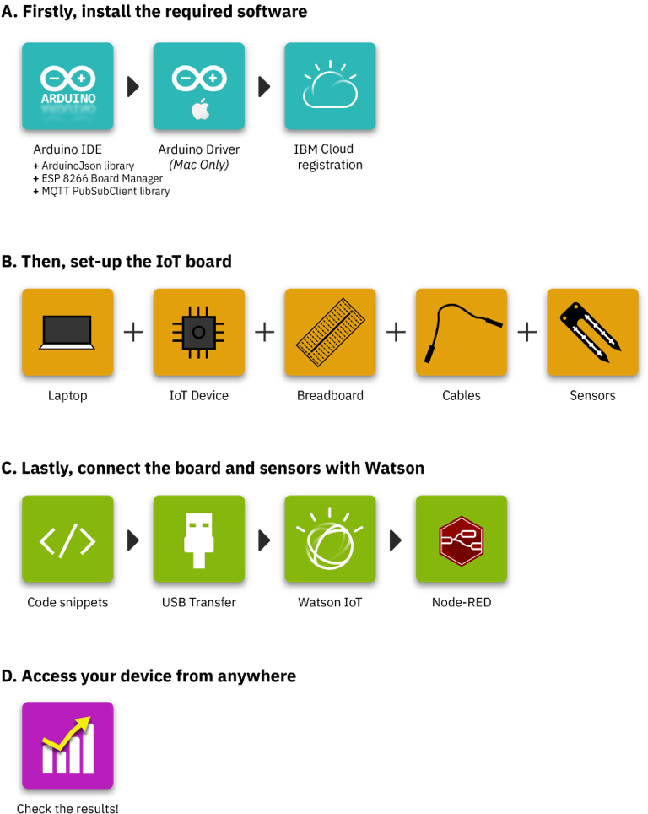
Introduction
Welcome ! This workshop will introduce you to the Internet of Things and the IBM Watson Internet of Things Platform (Watson IoT).
Watson IoT is a fully managed, cloud-hosted service to manage IoT devices and makes it simple to derive value from them. An IoT device can be a sensor, an actuator, a gateway or something else.
Through this guide, you will be able to connect an IoT device to Watson IoT, so that you can send data securely to the cloud using the open, lightweight MQTT messaging protocol. From there, you will be able to setup and manage your device, and stream its data into your online Watson IoT dashboard.
This guide walks you through the steps required to connect a sensor node to the Internet.
On the right of this slide you can find the workflow to connect your first IoT device and stream its data to the Internet. There are four main steps:

Slide 3
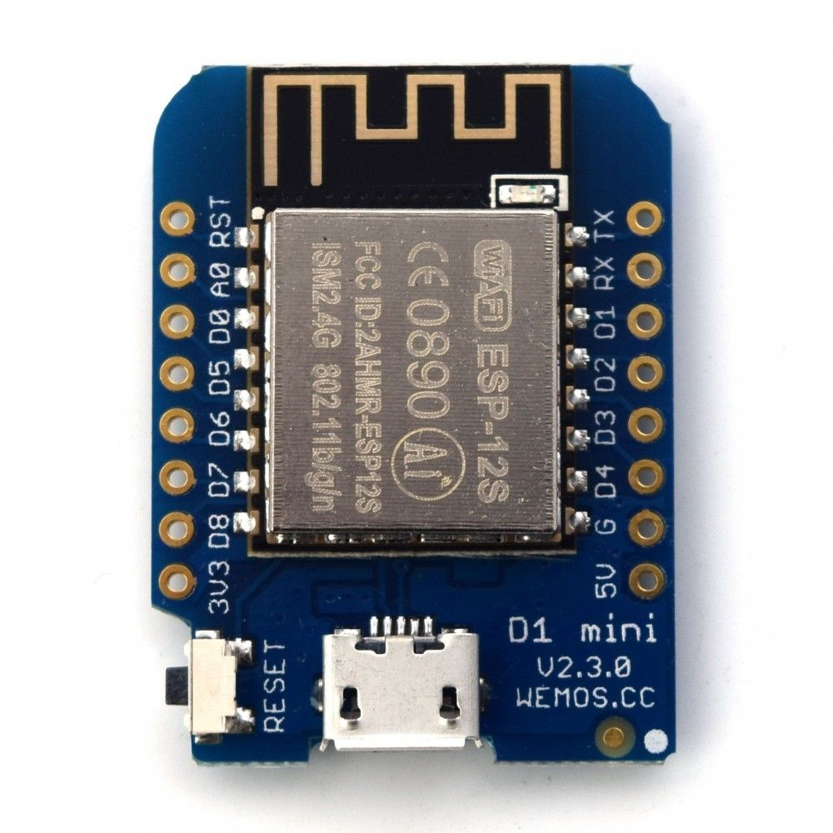
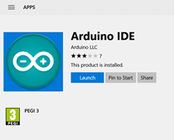
A. Install the required software
1. Install and launch the Arduino IDE
Arduino IDE is an interface development environment to program your IoT device. It is free and Open Source software, and it is quite popular amongst the IoT community. You need to install the Arduino for desktop to program your device later on in this workshop.
If you are a Windows 10 users, you can get Arduino from the Windows App Store.
If you have another Windows version, MacOS, or Linux, you can download the Arduino IDE installers from ibm.biz/ArduinoSoftware. Use a recent version of the IDE (1.8.5 or later).
After installation, launch the program.
2. Installing the drivers for the WeMos D1mini (ESP8266) board
To install the Arduino core for the D1mini follow the instructions using the “Installing with Boards Manager” option in the following website:
https://github.com/esp8266/Arduino#installing-with-boards-manager
Download and install the CH340G port driver for the board from this website:
https://wiki.wemos.cc/downloads

Slide 4
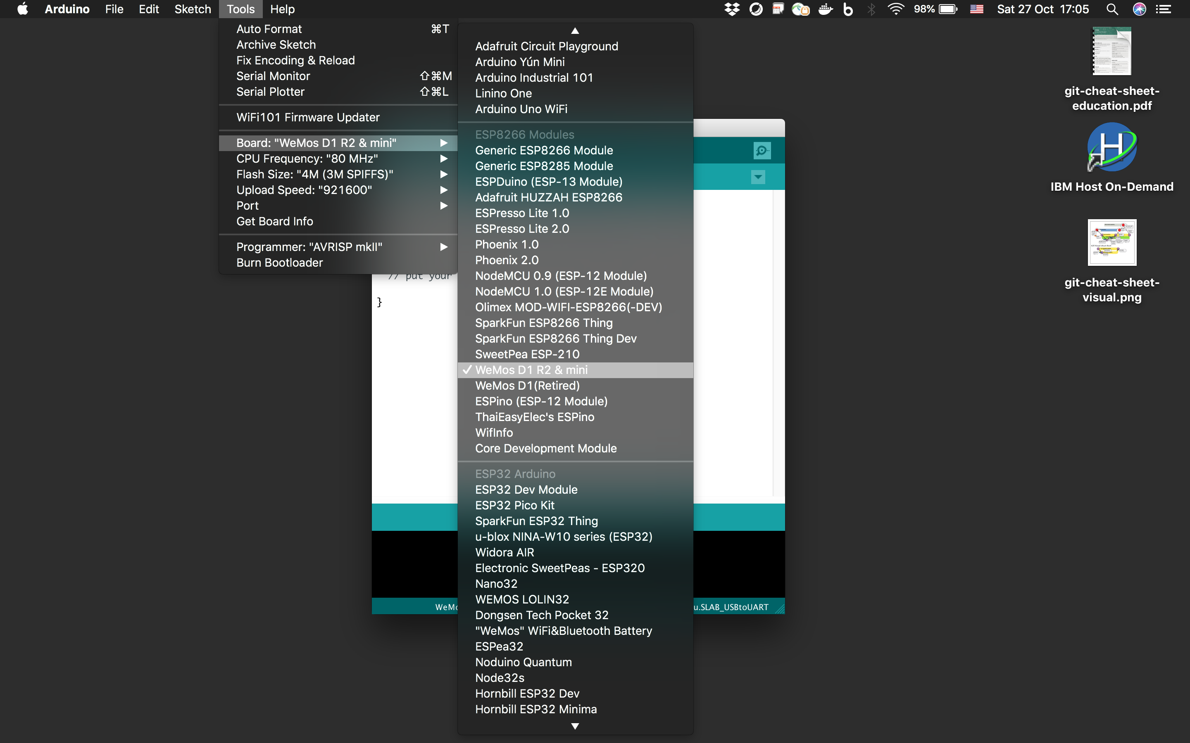
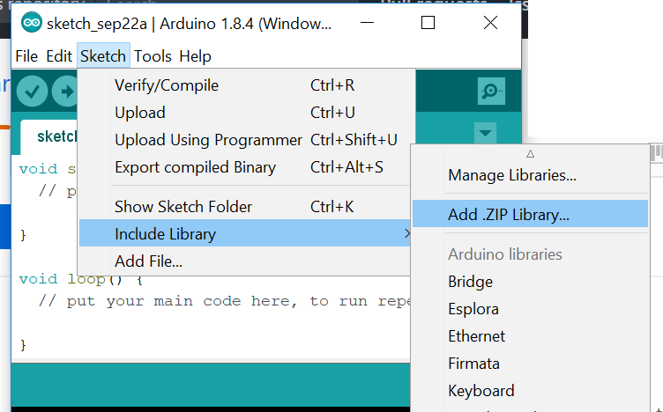
A. Install the required software
4 . Add the MQTT PubSubClient library
The IBM Watson IoT Platform uses the MQTT protocol, a messaging protocol. To properly communicate with the devices, you need to add the MQTT PubSubClient library to the Arduino IDE.
Download the following zip file: https://github.com/knolleary/pubsubclient/archive/v2.3.zip
Import the zip library to the Arduino IDE from the IDE menu option Sketch -> Include Library -> Add .ZIP Library. Here, select the downloaded .zip file (named pubsubclient-2.3.zip).
3. Select your board
Select “LOLIN (WeMos) D1 R2 & mini” or “WeMos D1 R2 & mini” module board from Tools > Board menu.

Slide 5
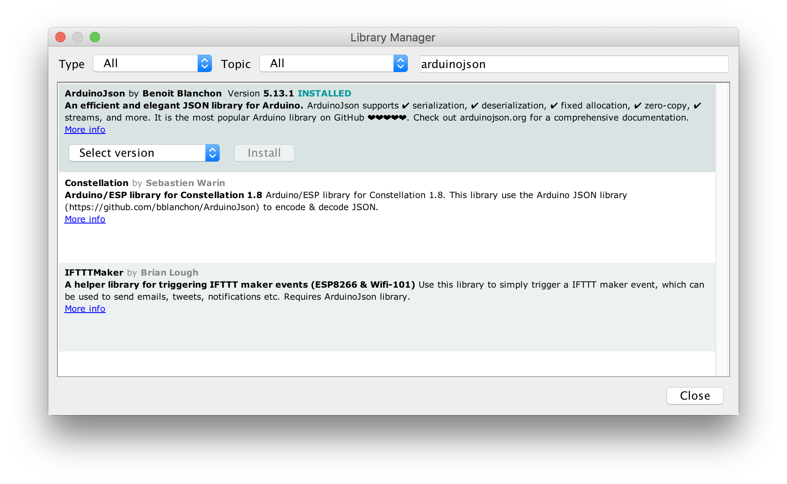
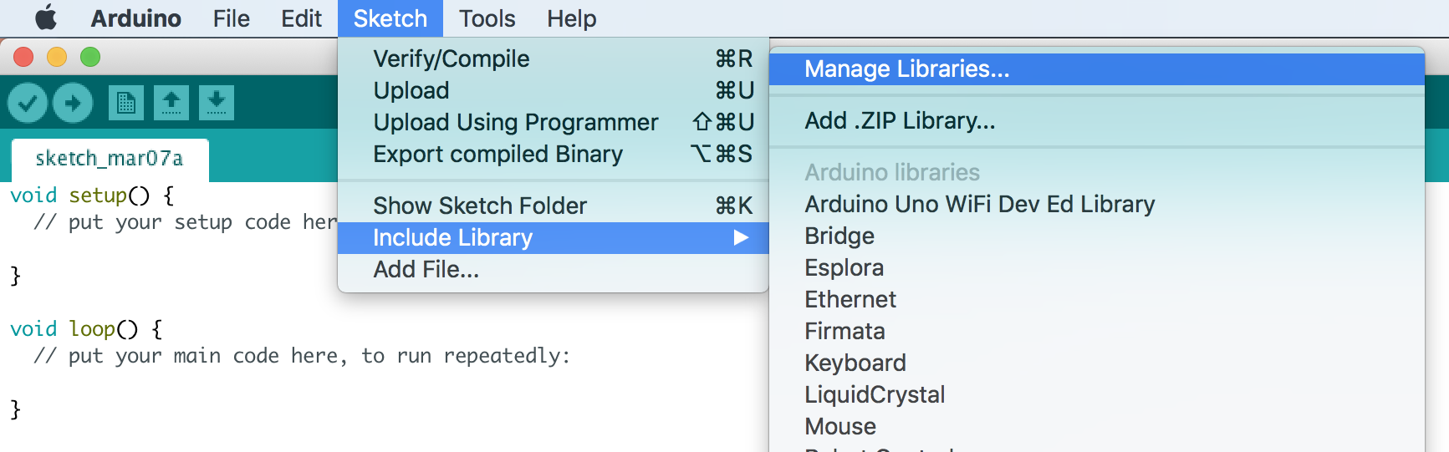
A. Install the required software
5. Add the ArduinoJson library
You can add libraries to the Arduino IDE from the IDE menu option Sketch -> Include Library -> Manage Libraries…
Here, search for “ArduinoJson”, and select and install the latest non-beta version of the library by Benoit Blanchon (for example, version 5.13.3).

Slide 6
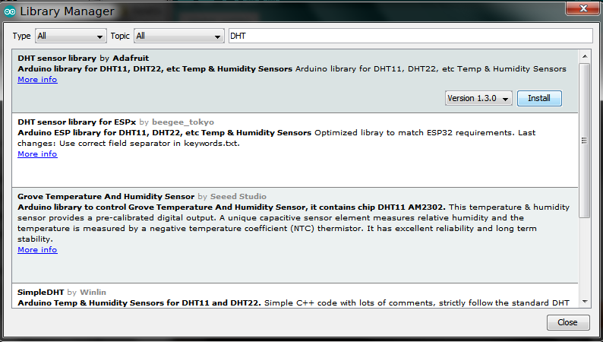
A. Install the required software
6. Add the DHT11 sensor libraries
In Sketch -> Include Library -> Manage Libraries… search for DHT. Install the DHT sensor library by Adafruit.
Still in the Library manager, search for the Adafruit Unified Sensor library and install it.

Slide 7
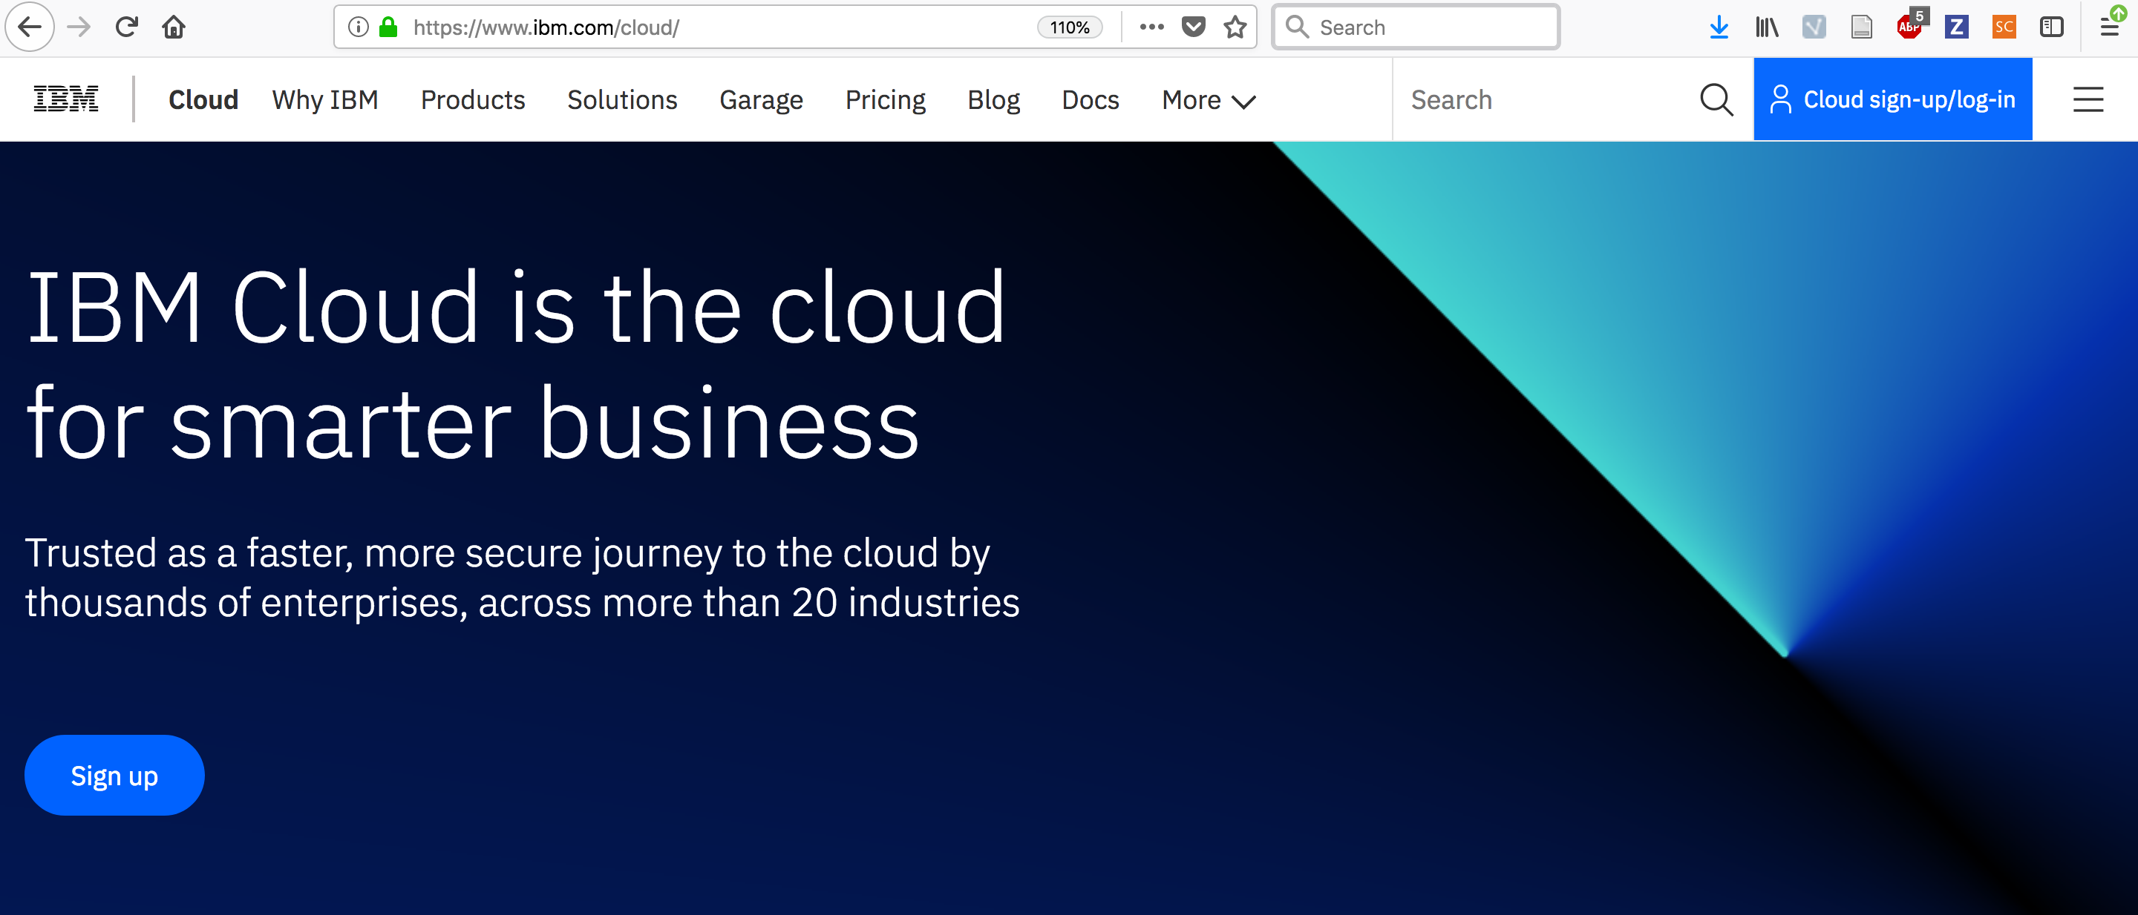
A. Install the required software
7. Register to IBM Cloud
IBM Cloud is a cloud platform as a service (PaaS) developed by IBM. The IoT device you'll be creating, has to send it's data somewhere. This is where IBM Cloud comes in.
If you do not have a working IBM Cloud account, you can register for a free trial at:
https://www.ibm.com/cloud/

Slide 8
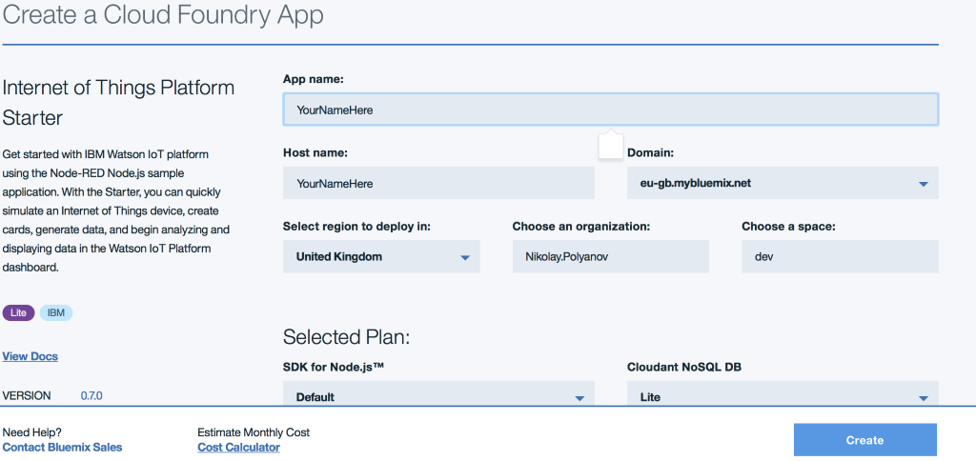
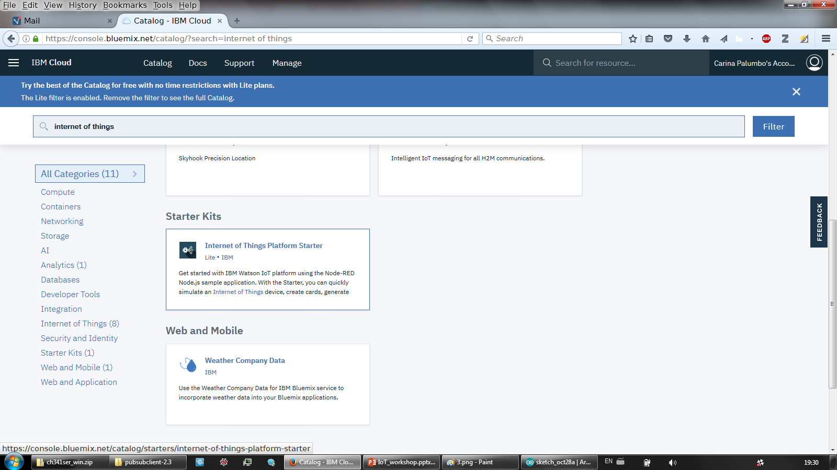
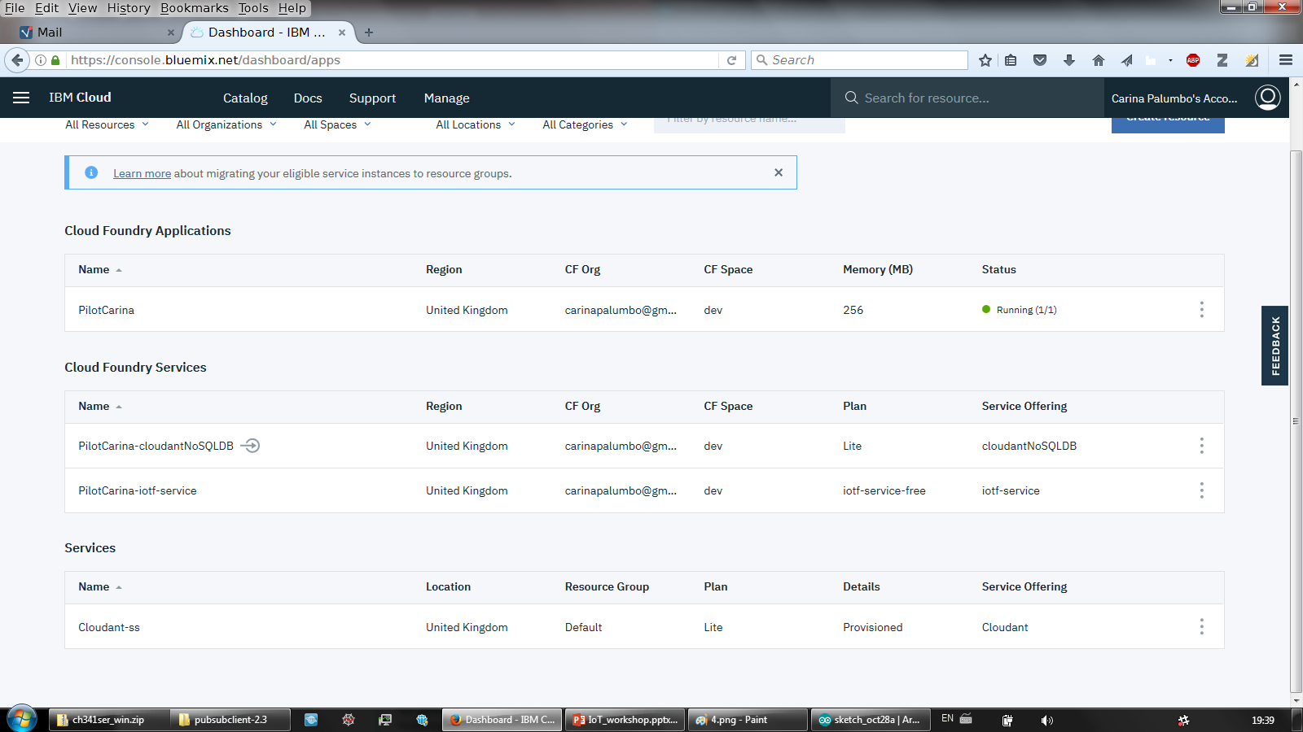
A. Install the required software
Click on IBM Cloud in the top left to go to your Dashboard. Take a look to get familiar with it.
Then press on “Catalog”.
In the search bar, type “Internet of things” and select “Internet of things Platform starter”.
Type your desired name in the “App name” field and press “Create” button. Wait until the app statos canges from starting to awake.
Go back to the IBM Cloud dashboard. Select the IoT plan under Cloud Foundry Services.

Slide 9
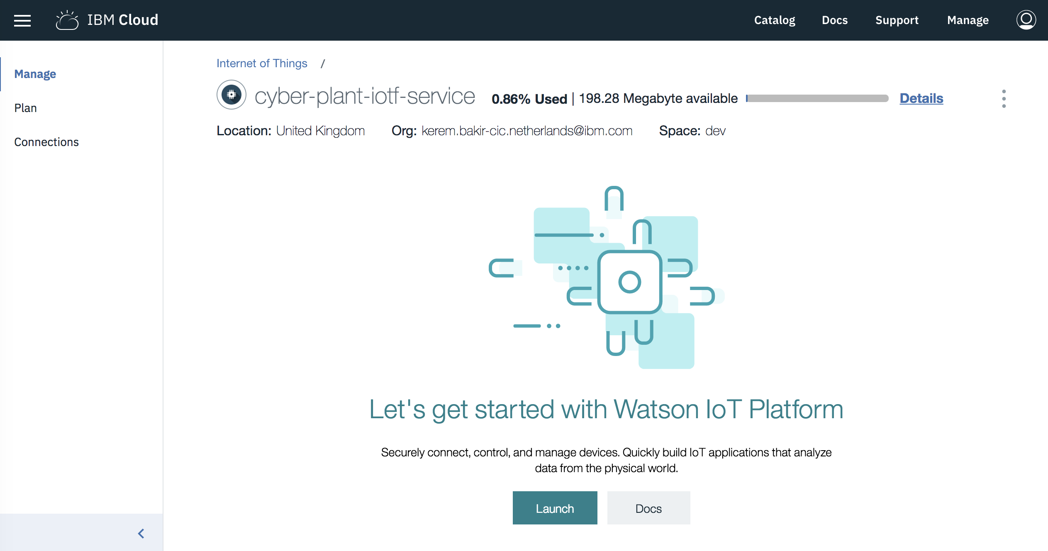
A. Install the required software
Proceed by launching the platform. This might take some time. If the progress indicator keeps loading for more than 2 minutes, please refresh your web browser.

Slide 10
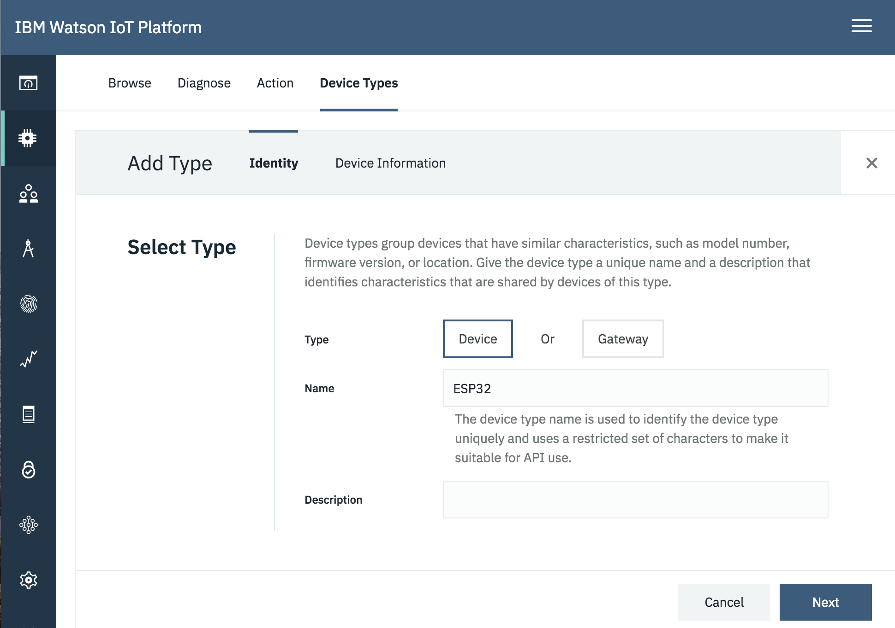
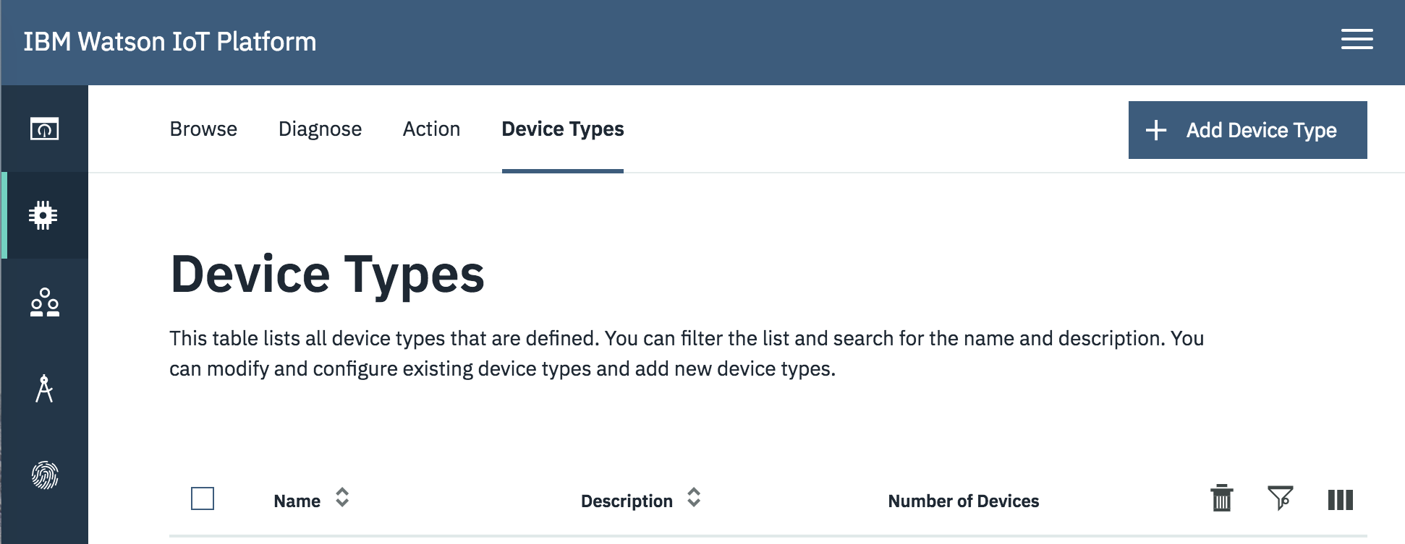
A. Install the required software
Choose Devices on the left menu and click on “Device Types”. Then click on “Add Device Type”. Make sure that you first go to “Add Device Type” before the “Add Device” section.
Name the device type “D1mini”. Proceed by clicking “Next”.
D1mini

Slide 11
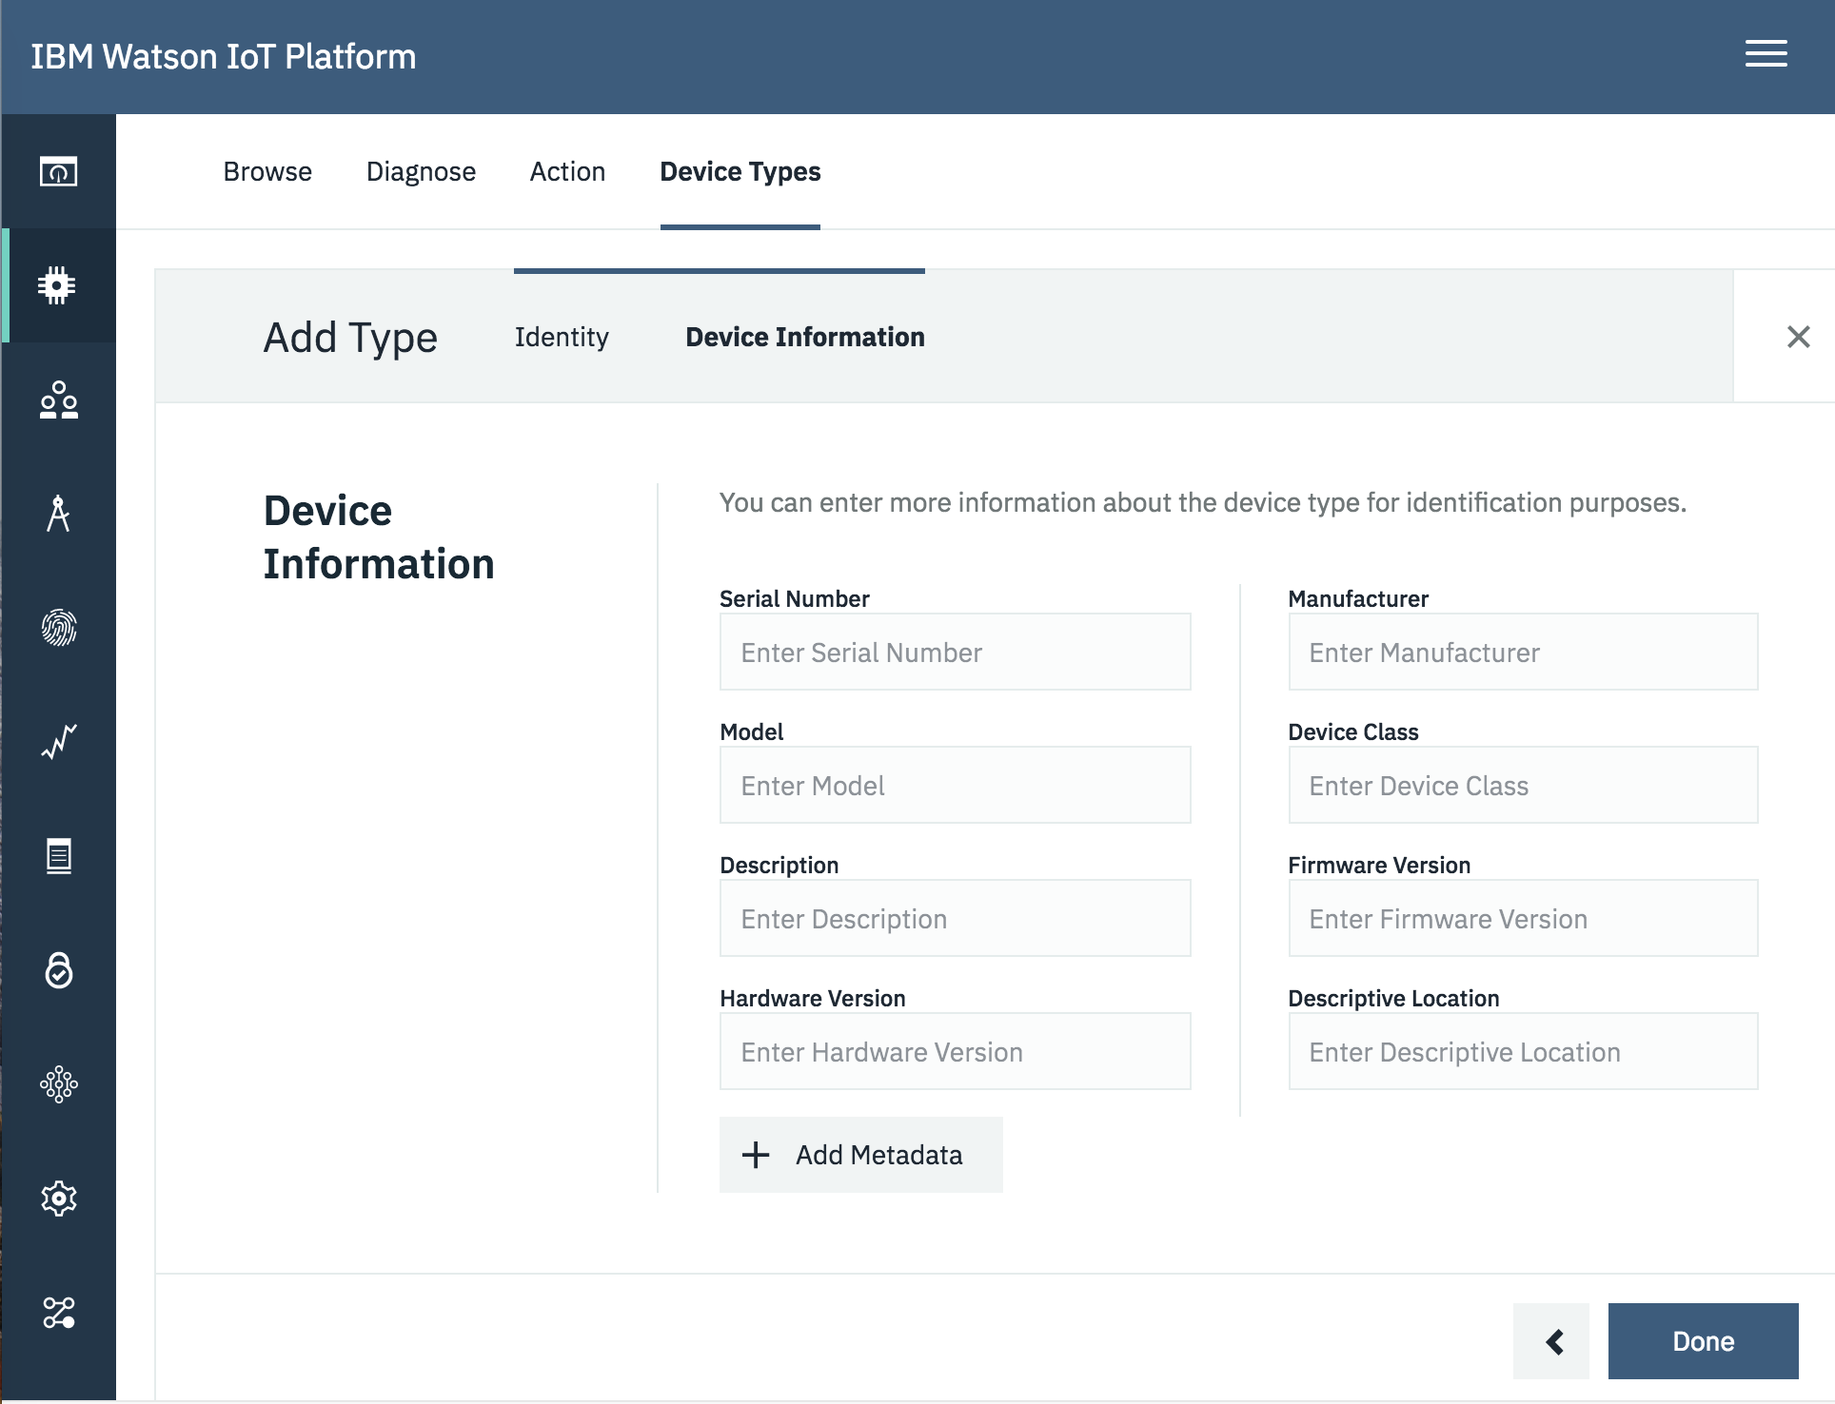
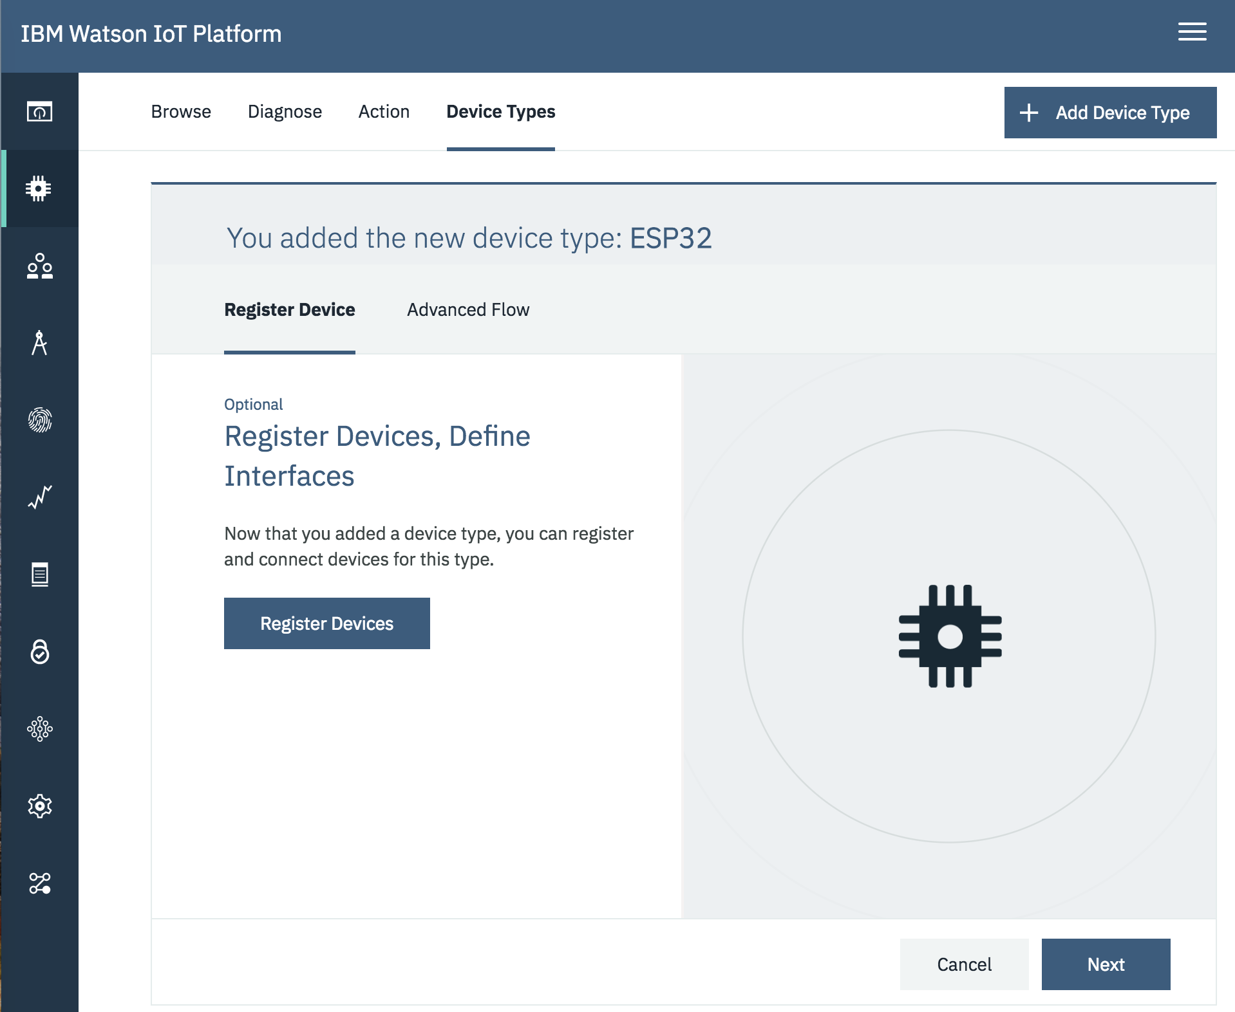
A. Install the required software
Guide to set your own IoT Device
Click on “Done”, leaving all Device information and Metadata tabs blank.
Click on “Register Devices”.

Slide 12
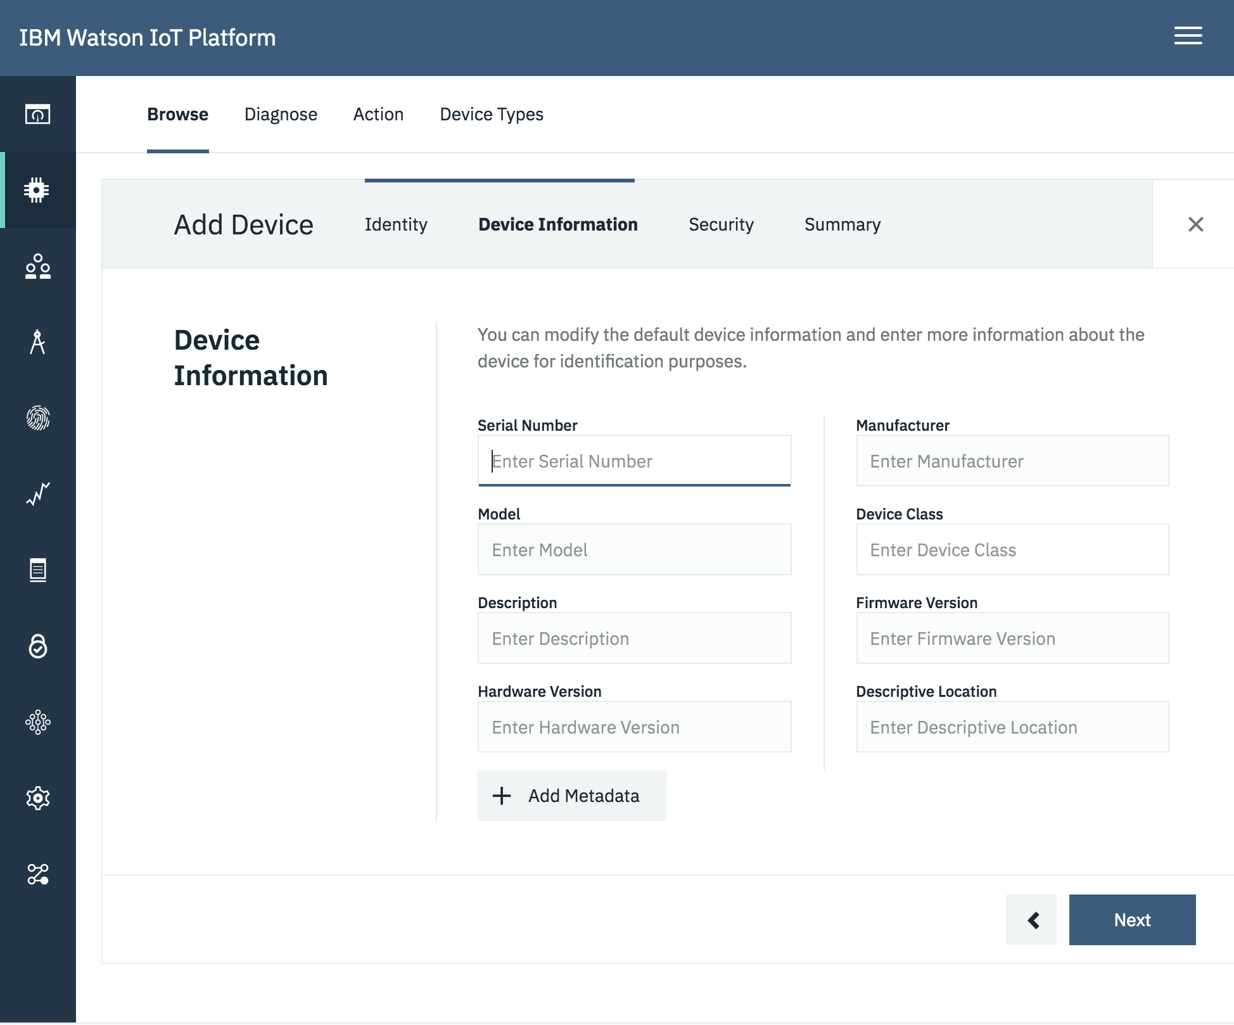
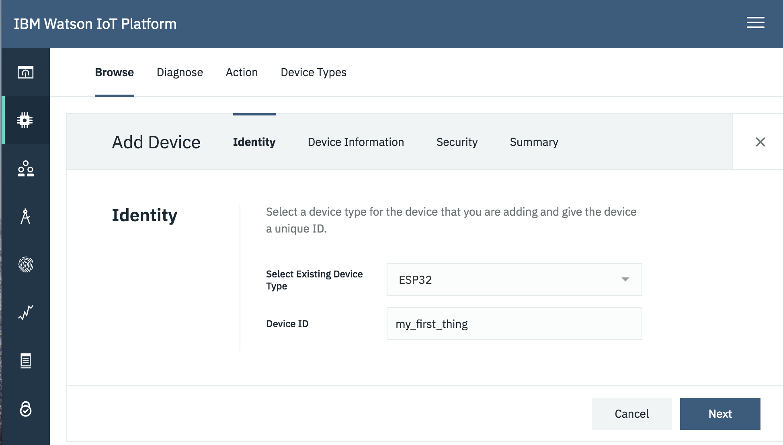
A. Install the required software
Now you have returned to the Add device menu. Make sure the created device type is selected. At the Device ID tab enter: ”my_first_thing” and click “Next”.
Open your notepad and take note of your device type and ID; you will need them later on.
Skip the Device information page by clicking ”Next”, leaving all and Metadata tabs blank.

Slide 13
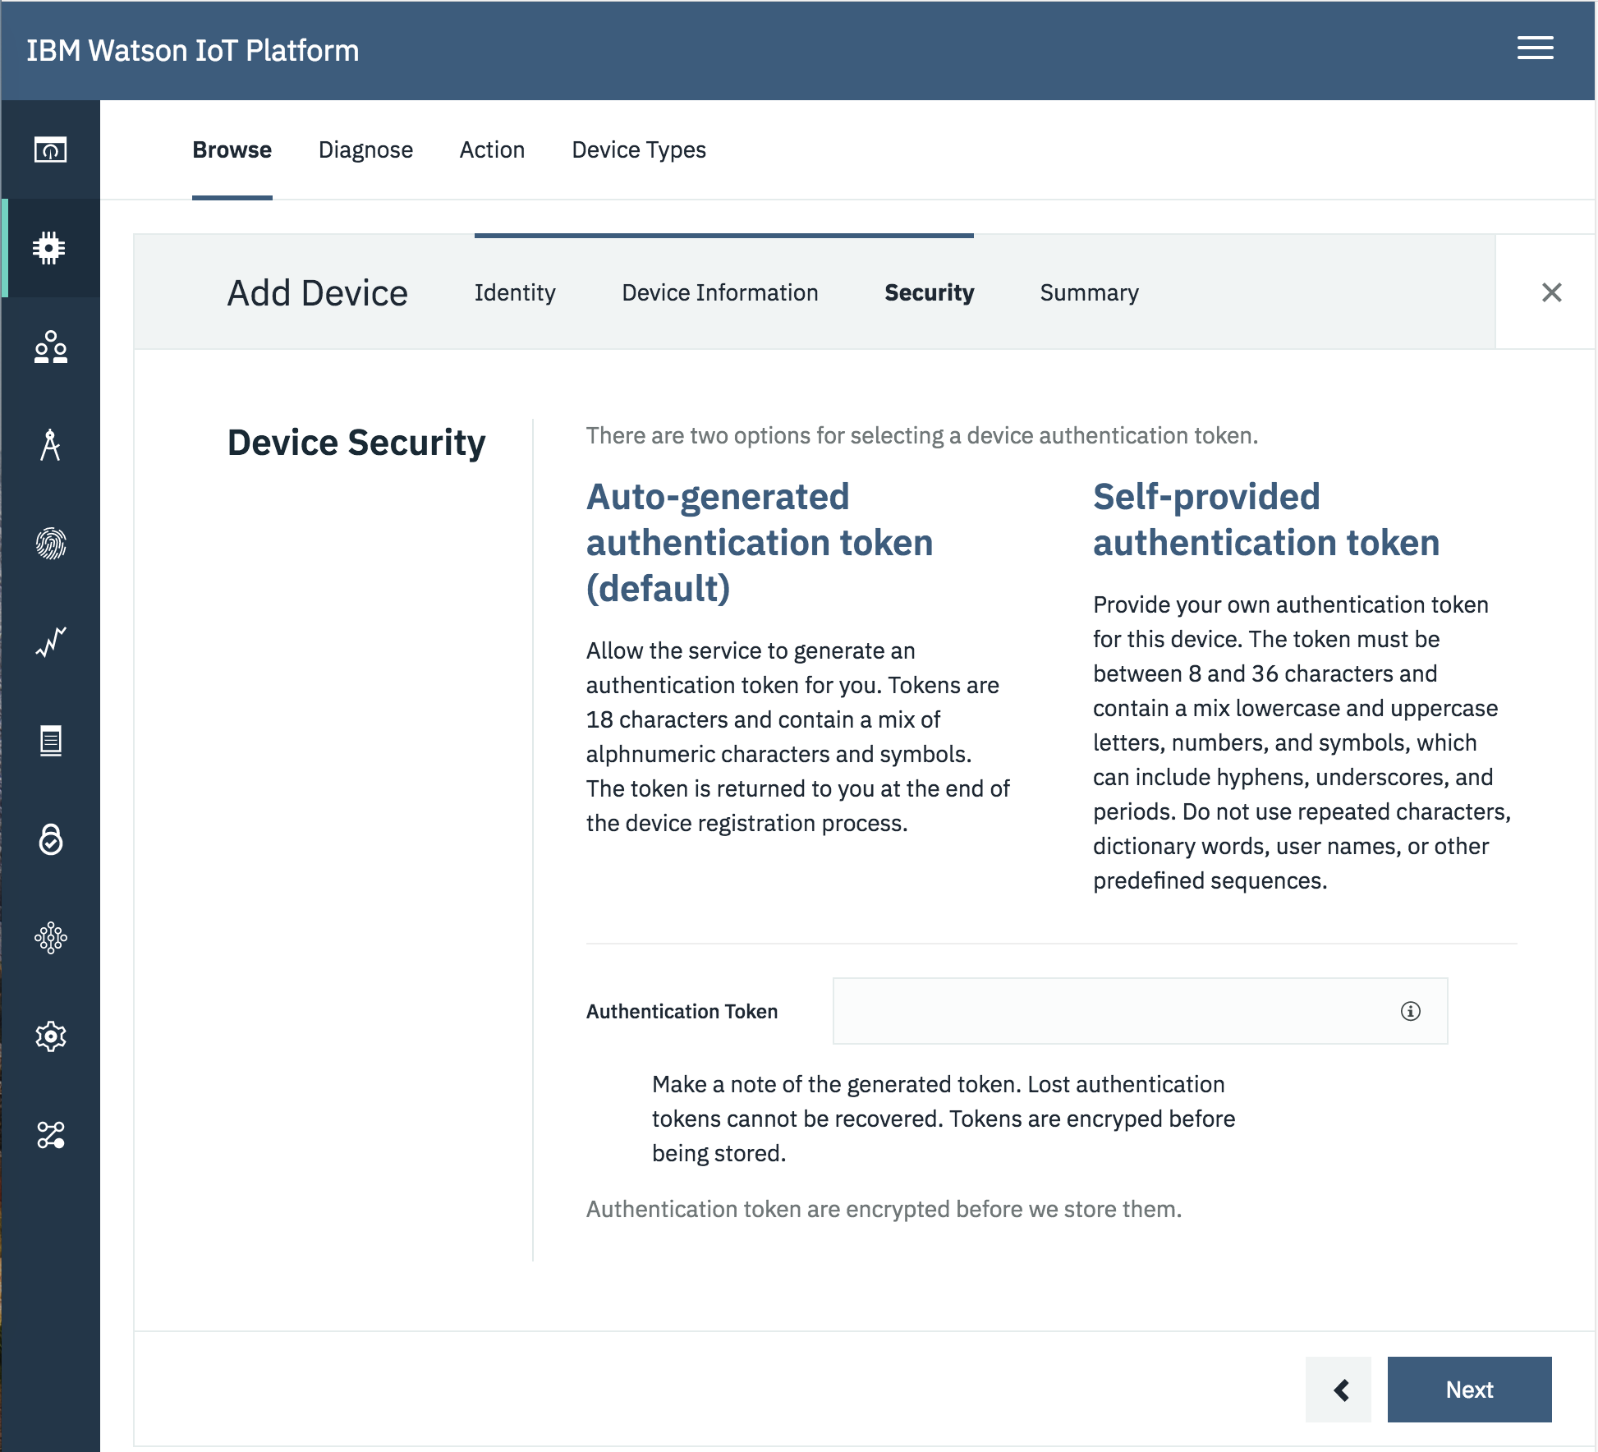
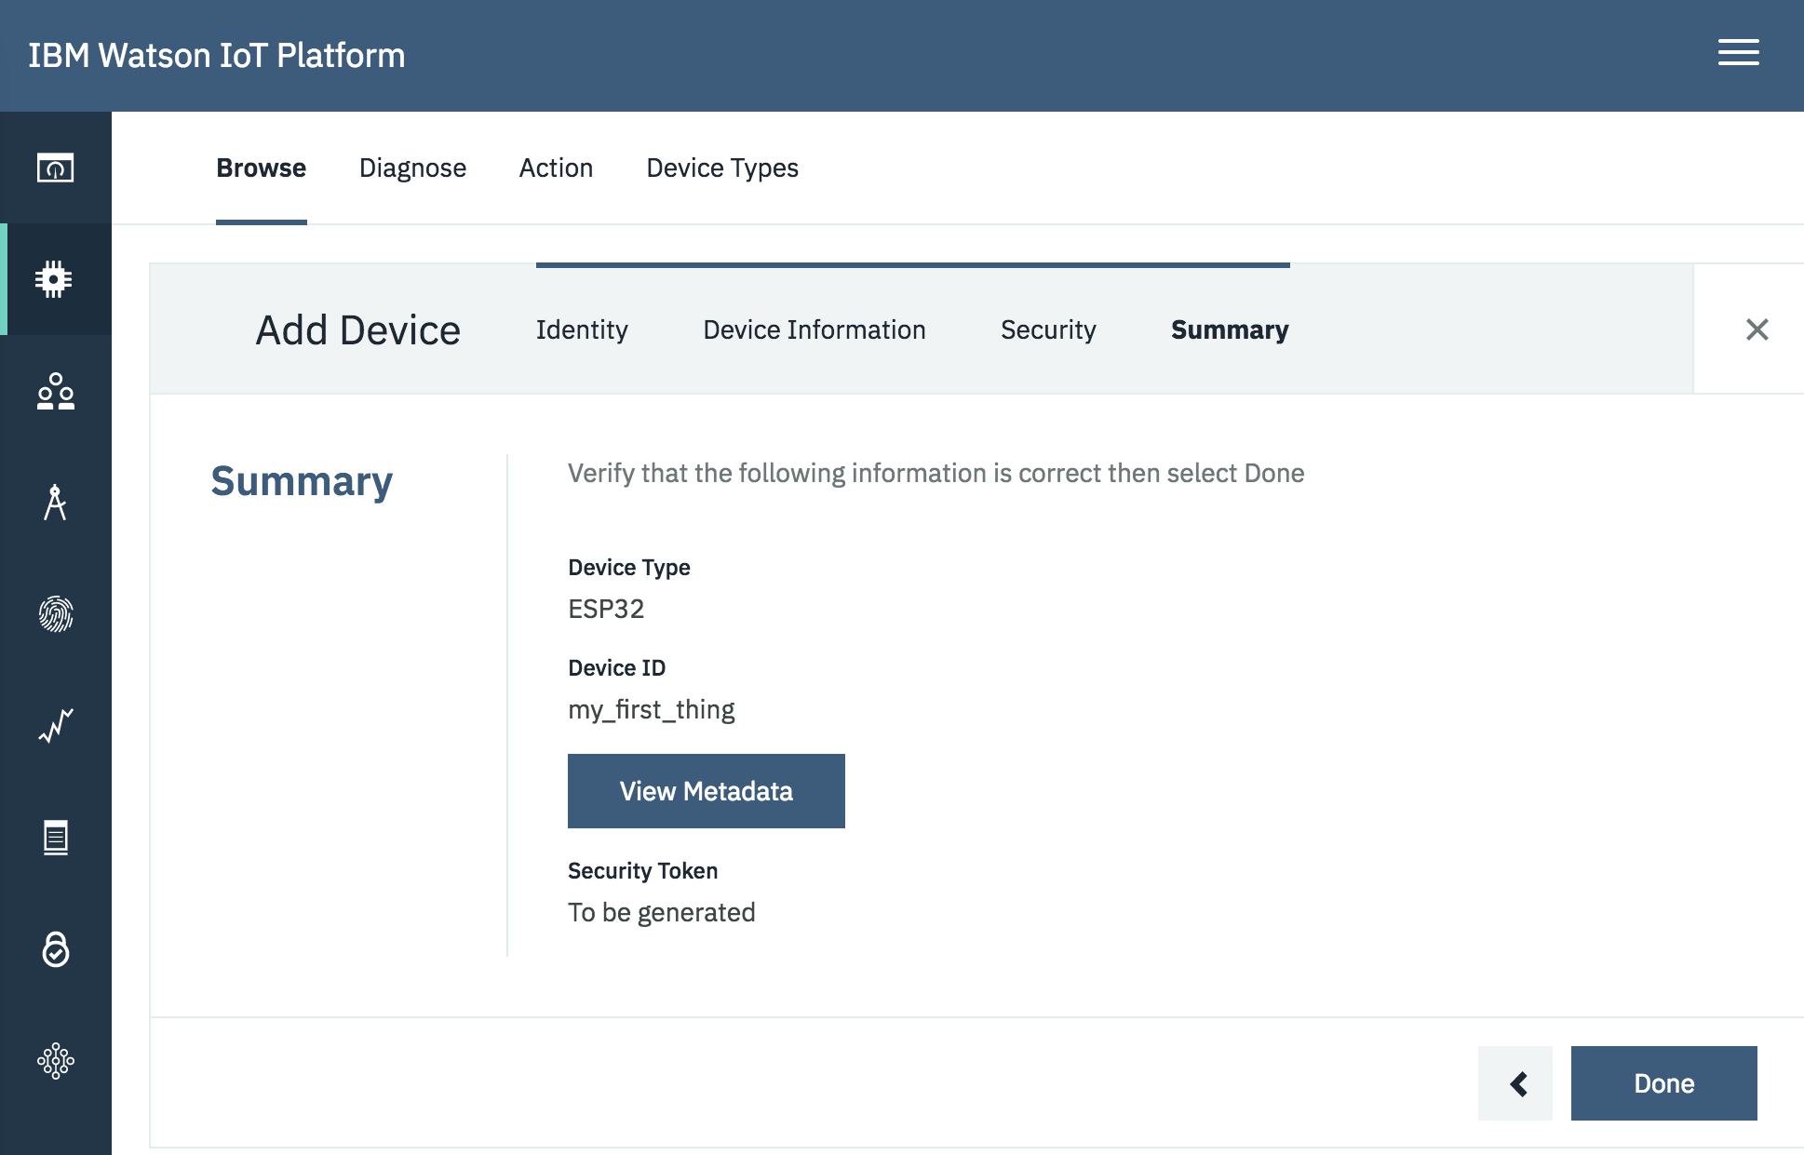
A. Install the required software
At the security step you can leave the Authentication Token tab blank and proceed by clicking “Next”. You will get the auto-generated token at a later step (see step 7.r).
At the summary step click “Done”.

Slide 14
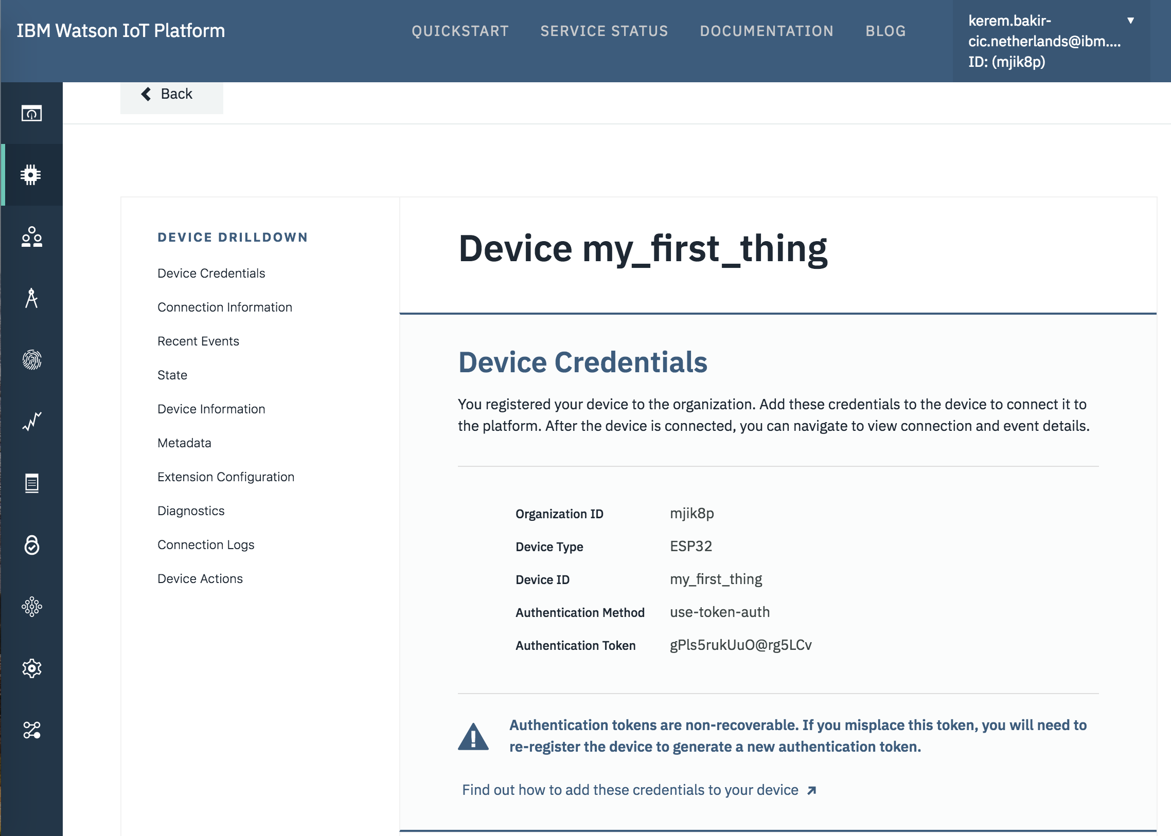
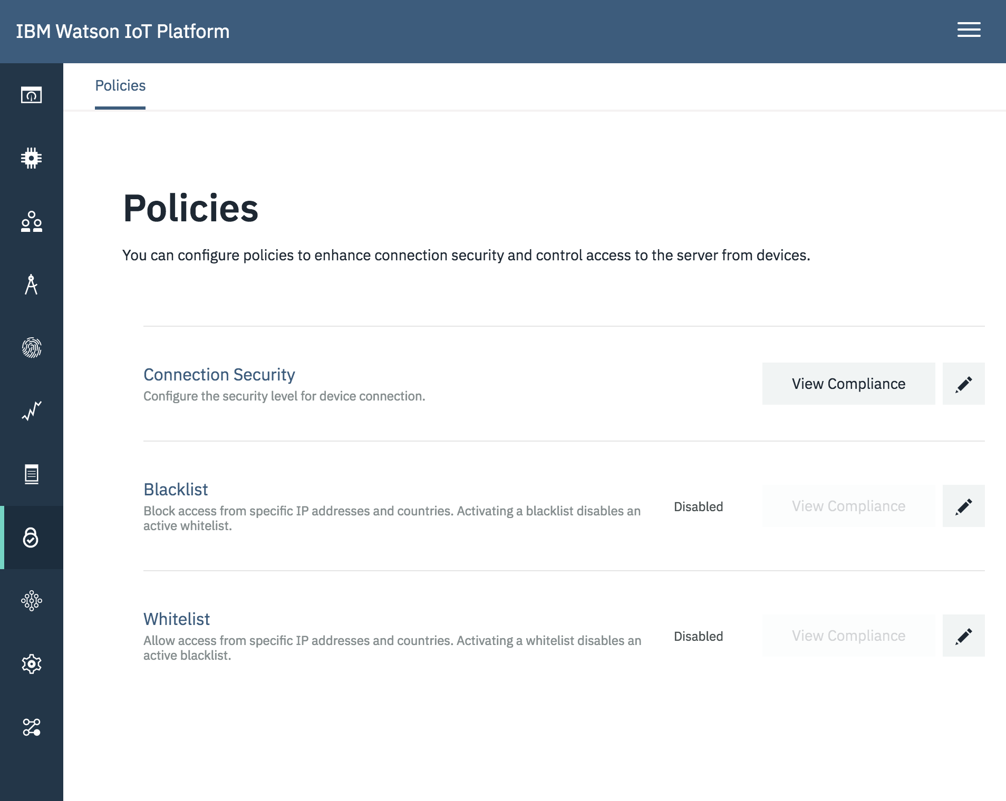
A. Install the required software
Now you have received your Device Credentials. If you have left the Authentication Token tab blank at step 15 you will also receive your auto-generated token.
IMPORTANT: Do not forget to copy the Organization ID and the Authentication Token. Paste them in you notepad. There is no option to retrieve the token at a later time.
After setting up your device, from the left menu go to Security > Connection Security and click on the edit button (pen icon).

Slide 15
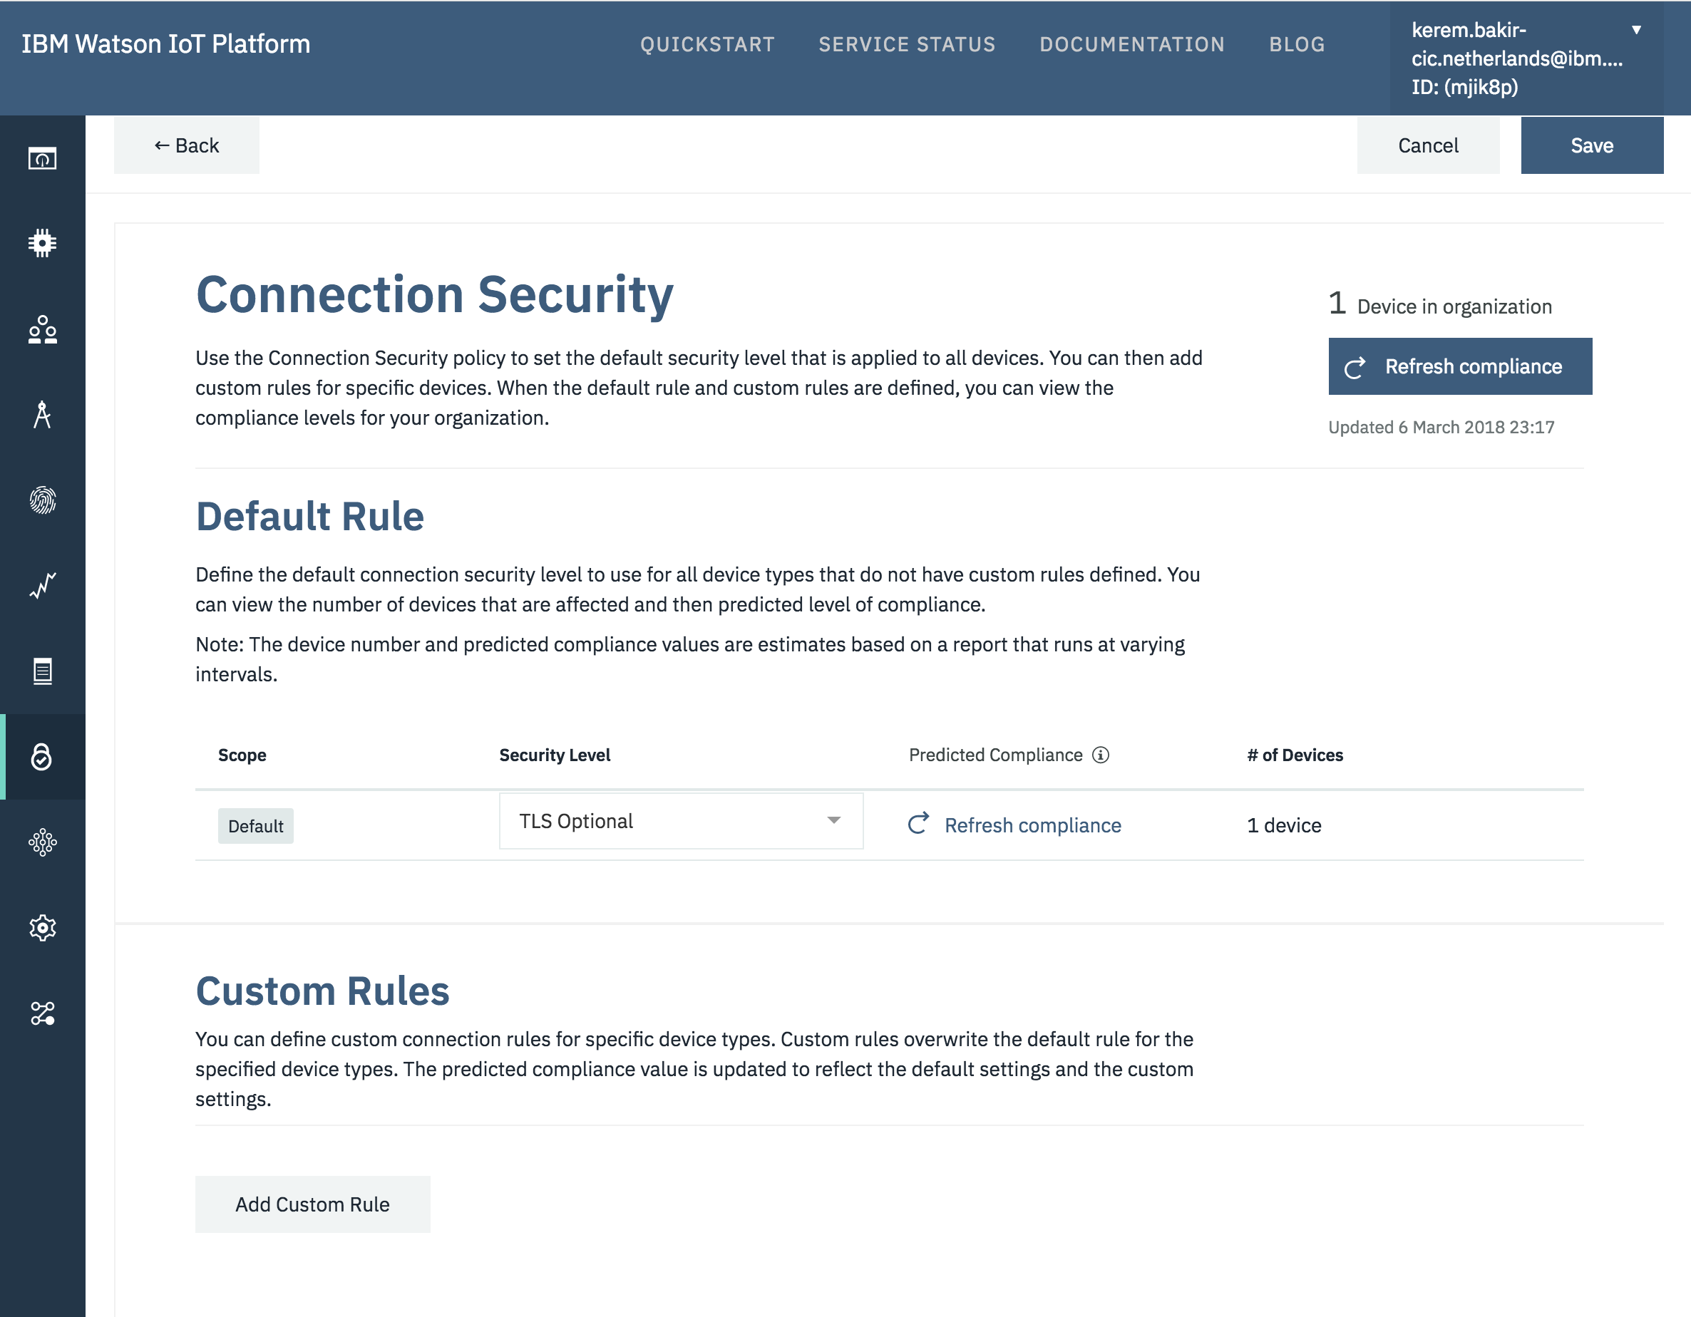
A. Install the required software
Under Default Rule, change Security Level to “TLS Optional”. Don't forget to “Save” your changes on top of the page
Congratulations!
You have installed the required software to set-up the IoT board and connect it to the IBM Watson Internet of Things Platform.

Slide 16
B. Set Up the Board
7. Connect your board
Okay! We have installed all requirements. Now, we will work on the board itself. There are a wide variety of IoT devices that can be connected to Watson IoT.
In this guide we use the WeMos D1mini. This board can be easily programmed using Arduino IDE. It uses the ESP8266 architecture. It has built-in USB and WiFi connectivity, making it highly suitable for prototyping.
That is why we installed the Arduino IDE and ESP8266 drivers in previous steps.
Connect your ESP8266 board to your computer using a micro-USB cable.
Check your board is visible in the USB port. To do so, in the Arduino IDE, click on Tools/Port.

Slide 17
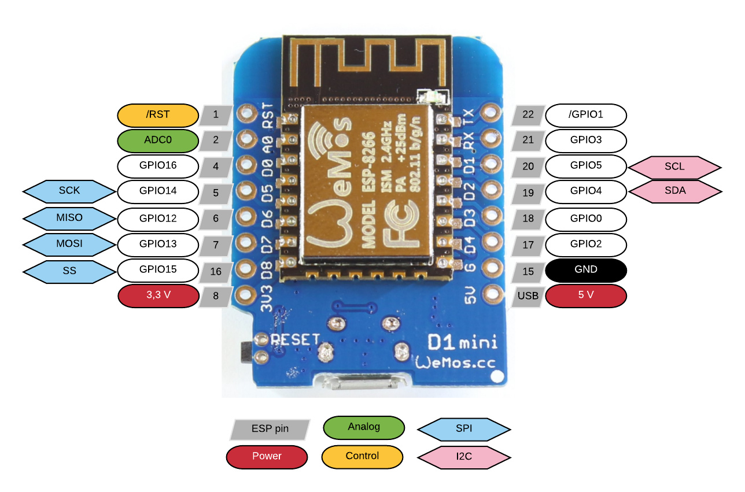
B. Set Up the Board
Layout of board pins
The pins on the edges of the board are interfaces to connect electronics such as sensors and actuators to the microcontroller.

Slide 18
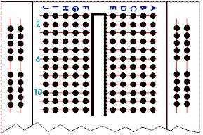
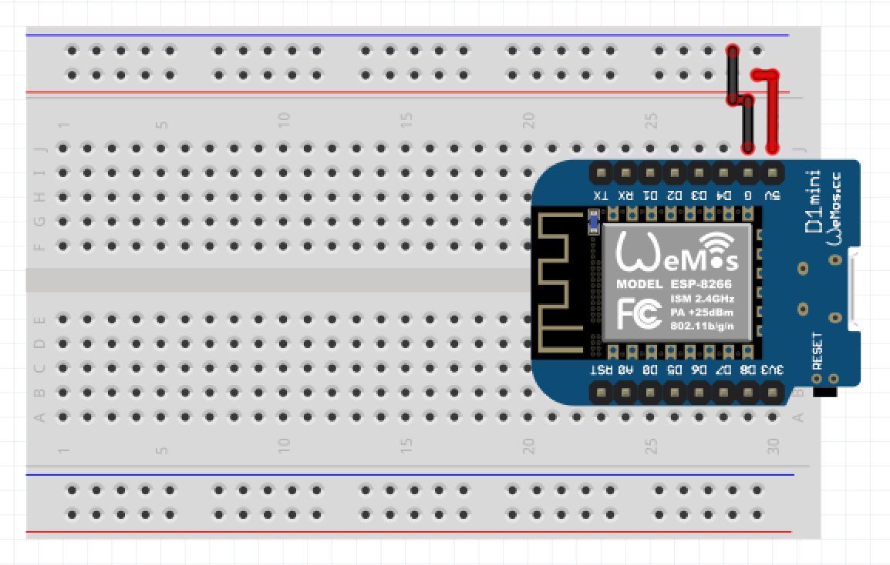
B. Set Up the Board
Place the WeMos D1mini board on your breadboard. Make sure your board is not connected to your computer. Connect the 5V and Ground pins to the red and blue breadboard lines, respectively.
Breadboard usage:
The red lines on the figure above show how some vertical columns and horizontal rows are internally connected.
When power is applied to the breadboard, current flows through these internal connections.

Slide 19
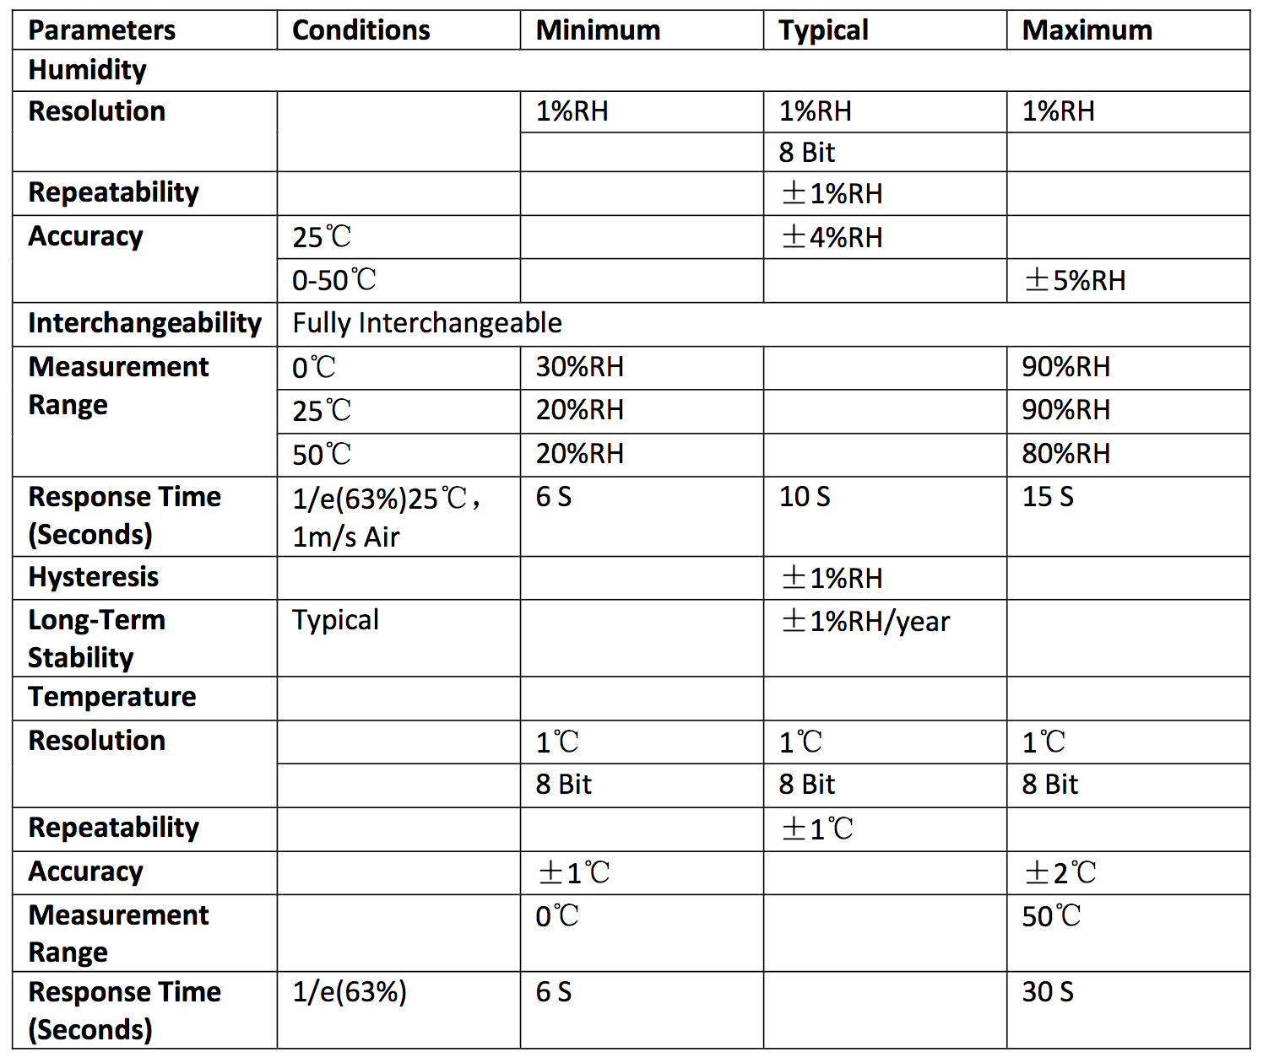
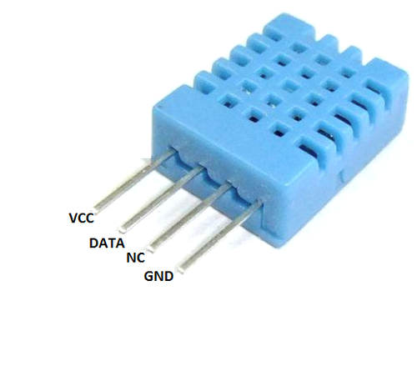
Temperature and humidity sensor (DHT11): specifications

Slide 20
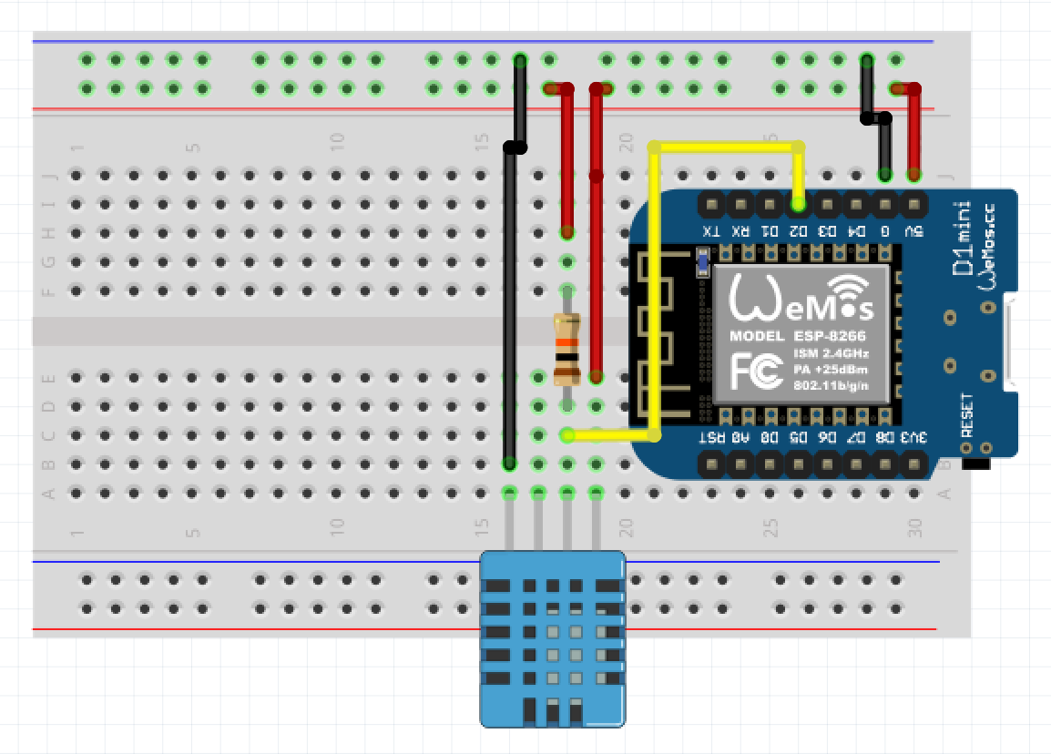
B. Set Up the Board
Connecting the T° and RH sensor
Connect the sensor power (VCC) pin to the breadboard 5V red line.
Connect the sensor signal (data) pin to the WeMos D2 pin.
Also, connect the sensor signal pin to the breadboard 5V red line by using a 10K Ohm resistor.
Finally, connect the sensor ground (GND) pin to the breadboard ground line.
The layout should look like the one in the left picture.

Slide 21
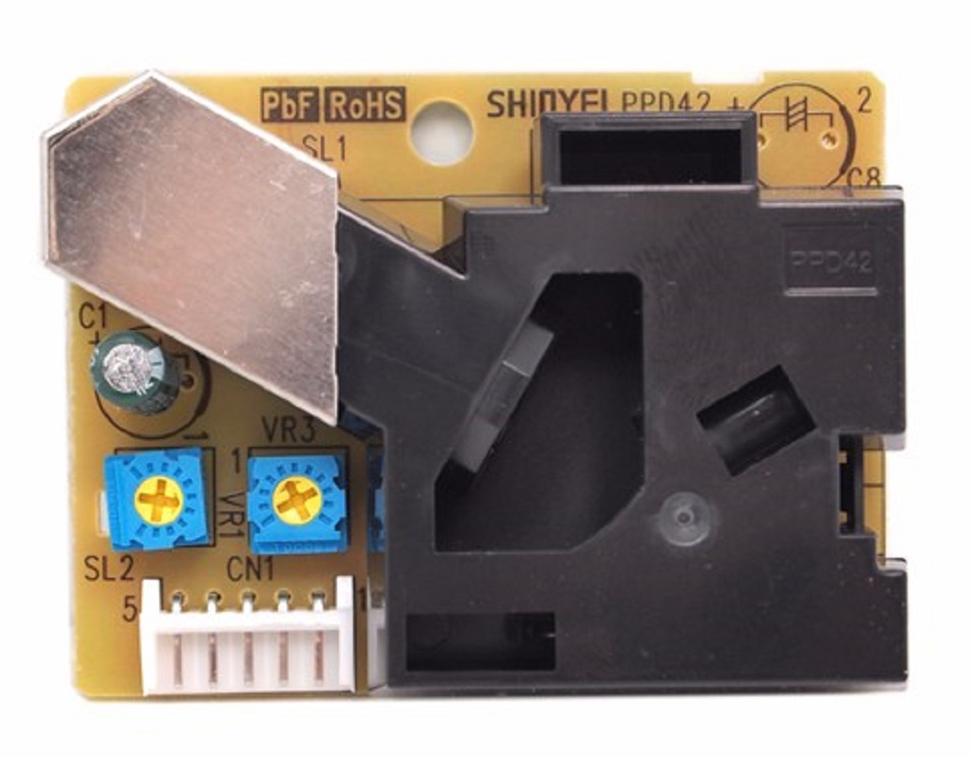
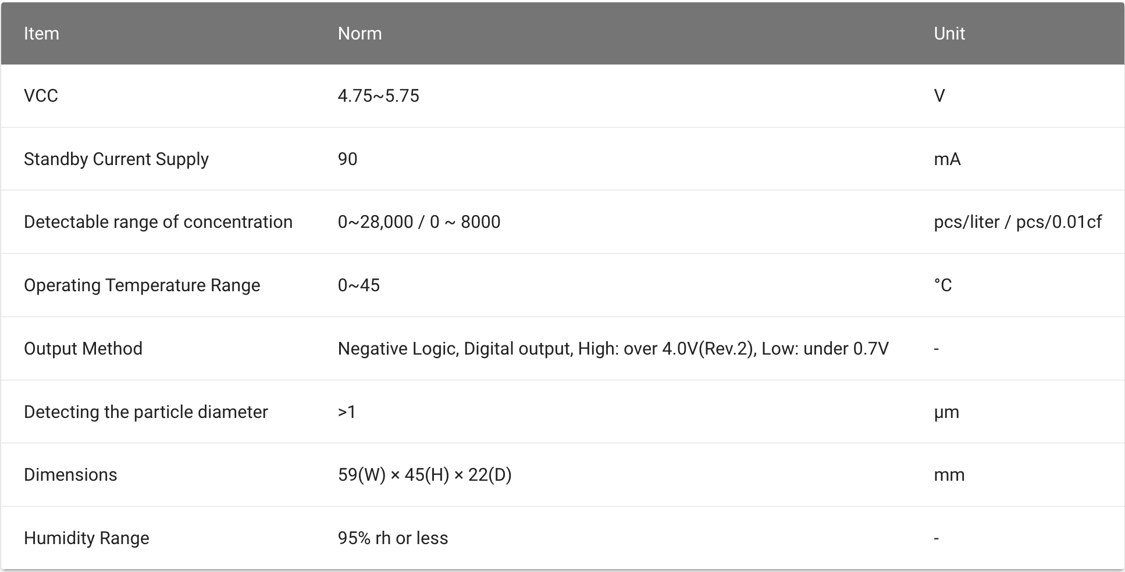
Dust sensor (PPD42): specifications
Pin | Description
1 | Ground
2 | Signal out: 2,5 to 10,0 um
3 | VDC, power in (5V)
4 | Signal out: 1,0 to 10,0 um
5 | Input (T1)
Pin | 5 | 4 | 3 | 2 | 1

Slide 22
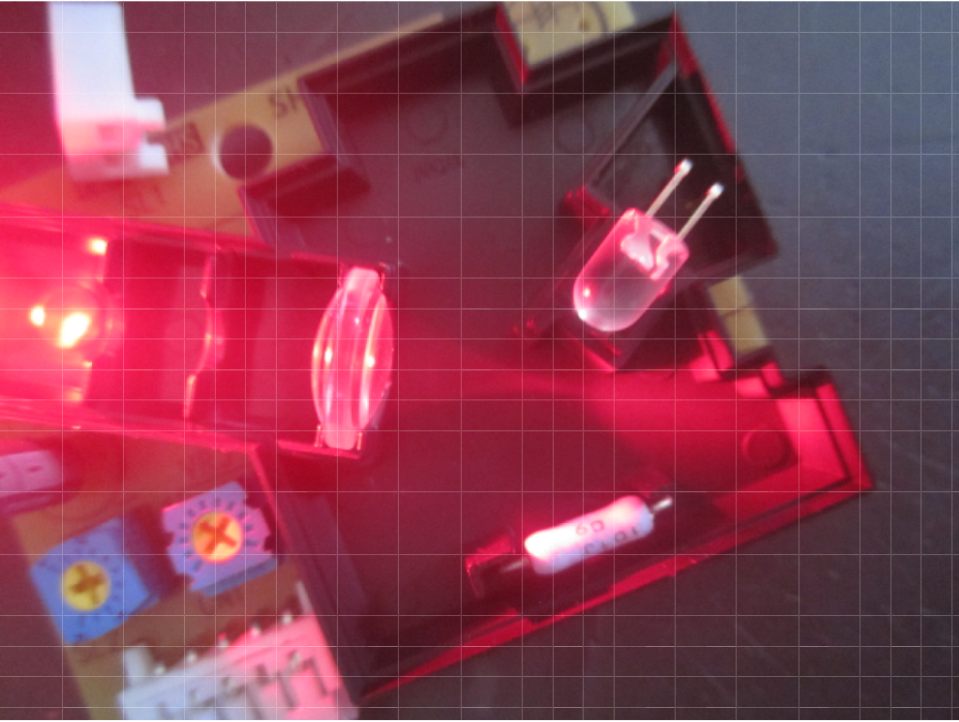
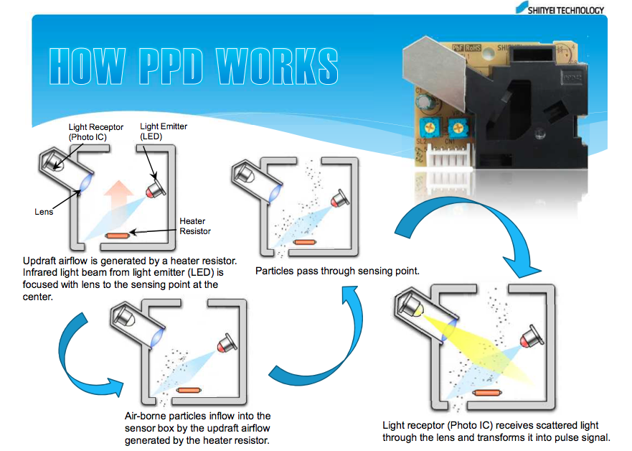
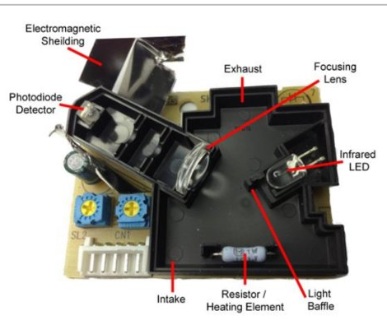
Dust sensor: specifications

Slide 23
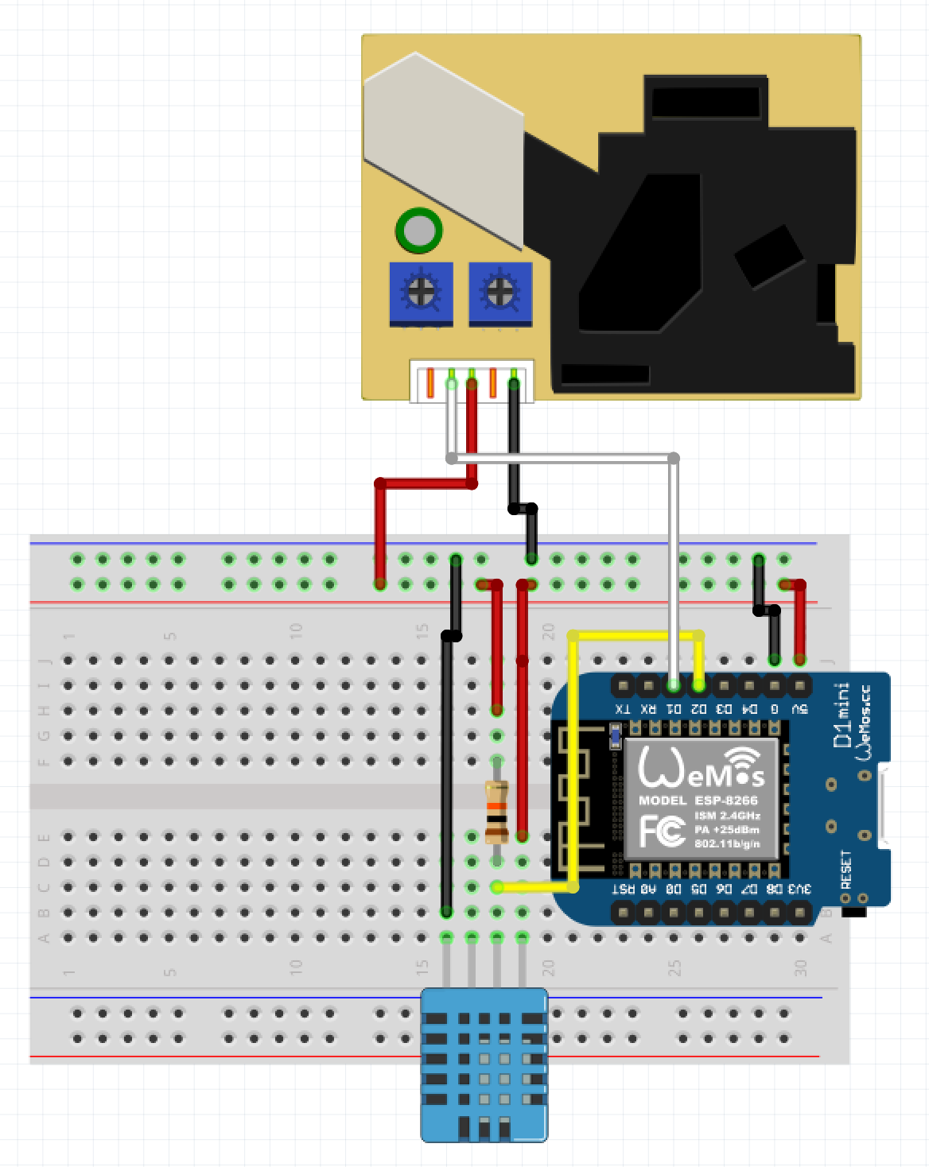
B. Set Up the Board
Connecting the dust sensor
Connect the WeMos D1 pin to the sensor signal pin (pin 4).
Connect the breadboard 5V line to the sensor power pin.
Finally, connect the sensor ground pin to the breadboard ground line.
The layout should look like the one in the left picture.

Slide 24
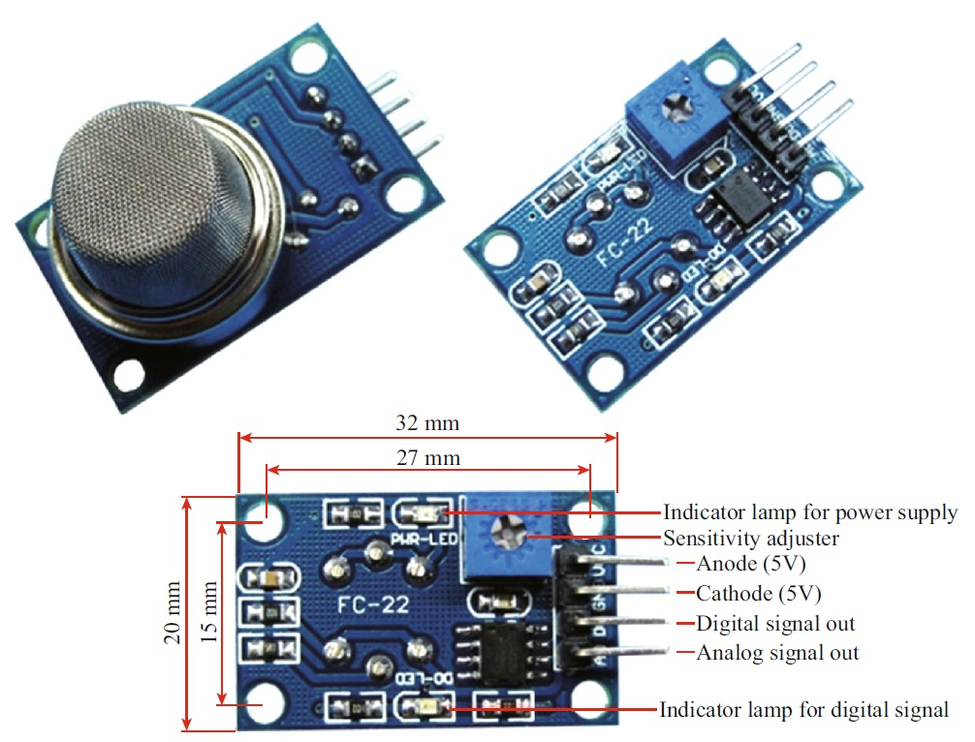
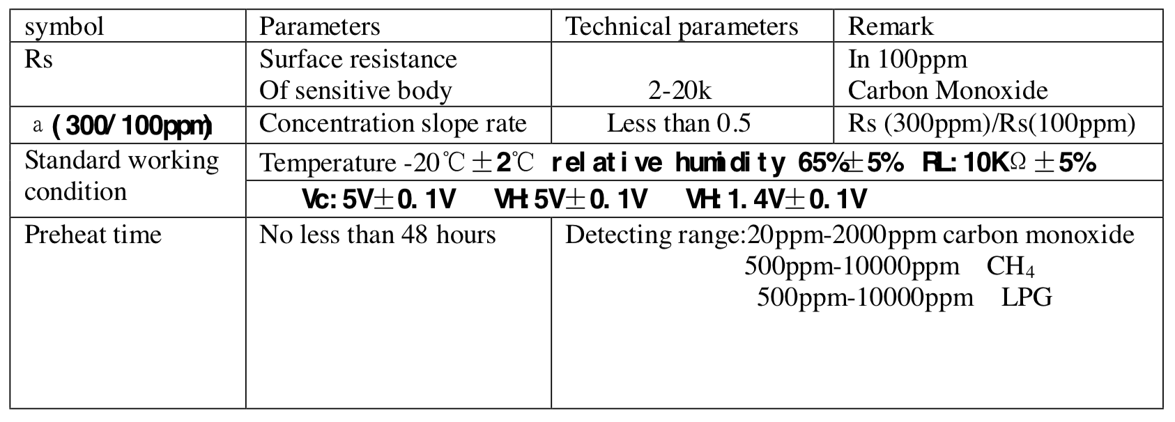
Gas sensor (MQ9): specifications
Power in
Ground

Slide 25
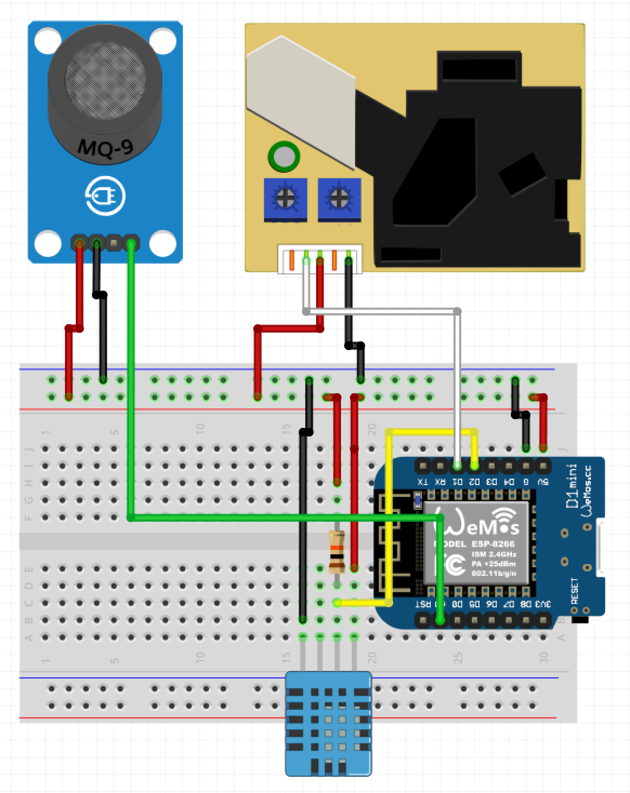
B. Set Up the Board
Connecting the dust sensor
Connect the WeMos A0 pin to the sensor signal out pin.
Connect the breadboard 5V line to the sensor power pin.
Finally, connect the sensor ground pin to the breadboard ground line.
The layout should look like the one in the left picture.

Slide 26
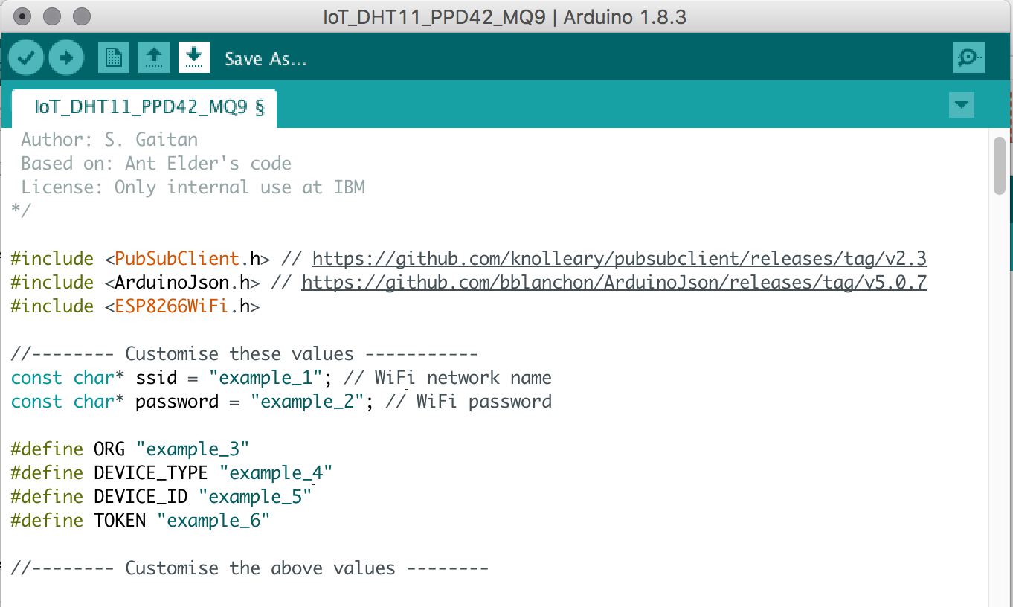
C. Connect the Board and Sensors to Watson IoT
Loading and running the Arduino code
Now, you have to program some code to tell the device what it actually should do. Here, you will tell the device to send the moisture value to IBM Cloud. Then, you can upload the code to the device, disconnect the device from your computer and let it measure the moisture level from anywhere in the world.
Connect your board USB cable to the computer again.
Launch Arduino IDE and open a new sketch. Replace the code in the Arduino editor with a copy of the following code:
https://github.com/santjaqo/air_quality/raw/master/WatsonIoT_workshop/IoT_DHT11_PPD42_MQ9/IoT_DHT11_PPD42_MQ9.ino
At the top of the code, include your WiFi’s network name and password. You can set a WiFi hotspot in your mobile phone if required.
Edit the values for ORG, DEVICE_TYPE, DEVICE_ID and TOKEN. You took note of these values earlier in this guide.

Slide 27
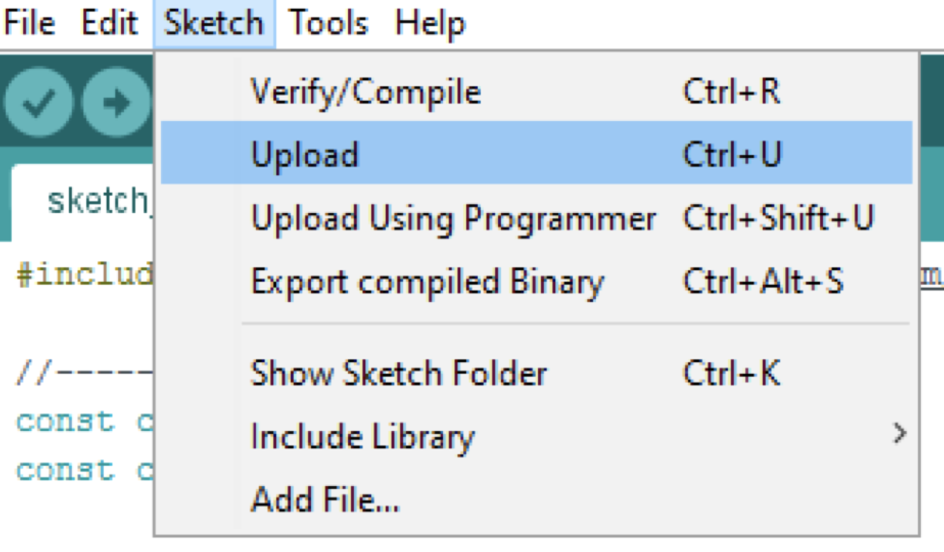
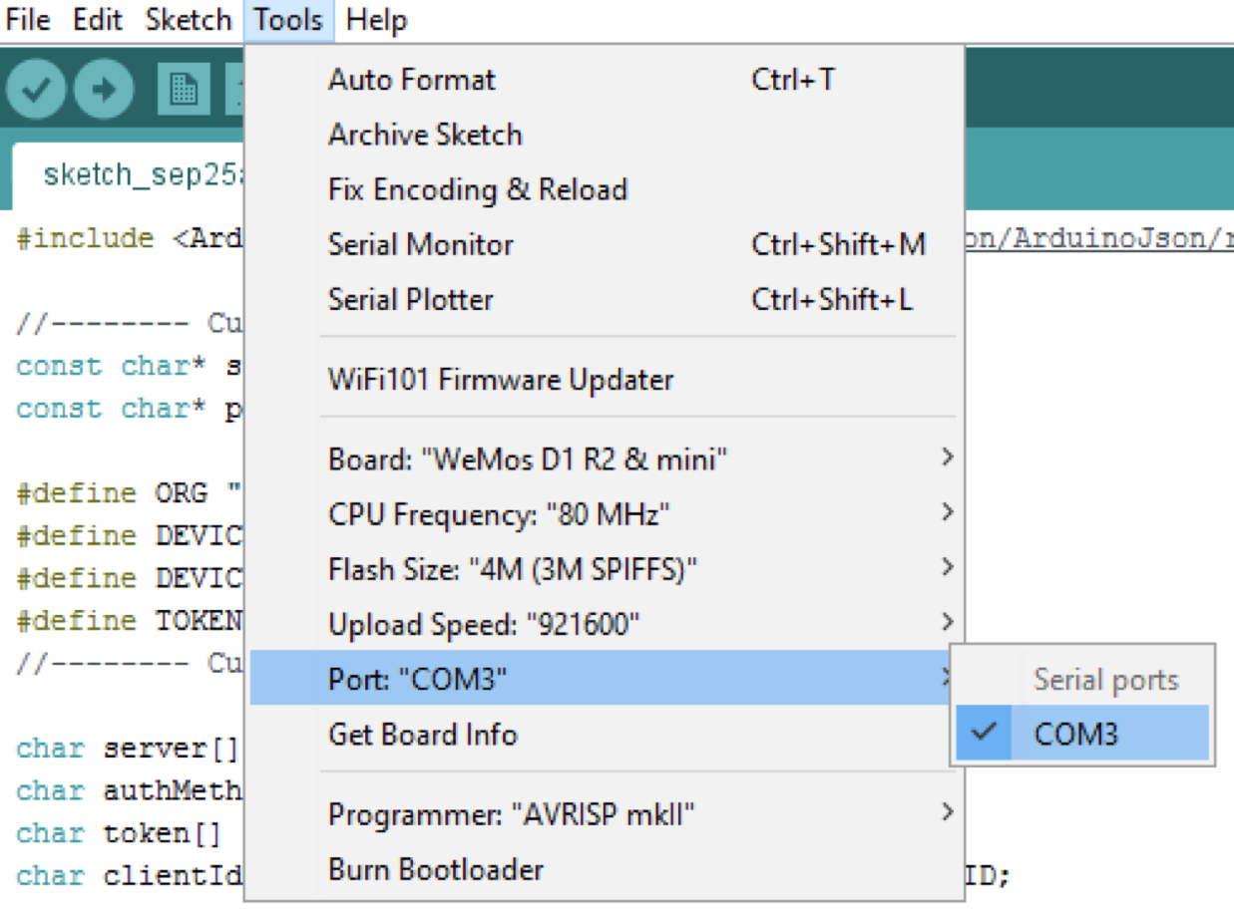
C. Connect the Board and Sensors to Watson IoT
Upload the sketch to the ESP8266 board (Sketch>Upload->Save in default folder)
If the error message: "Failed to open COMx" occurs (where x can be any number), go to Tools>Port and select the correct COM port. If the WeMos is the last USB device you connected to your computer, then use the port named with the higher number.

Slide 28
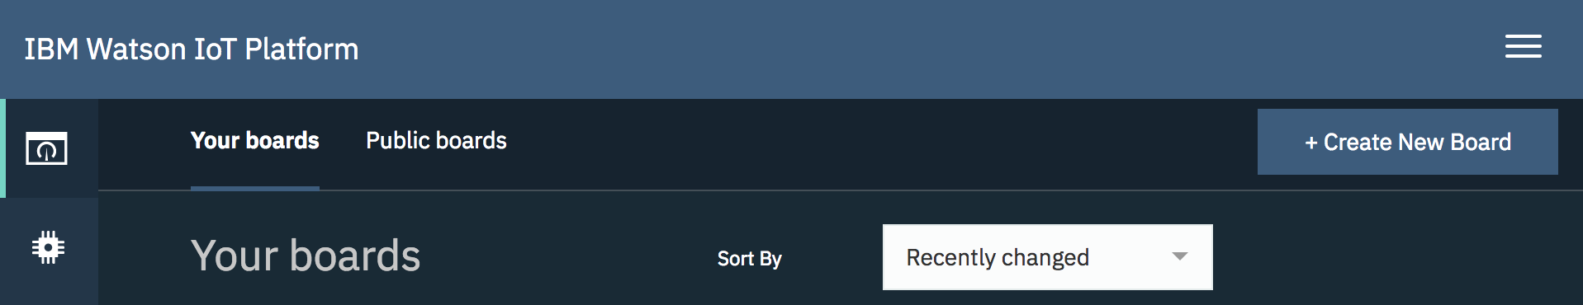
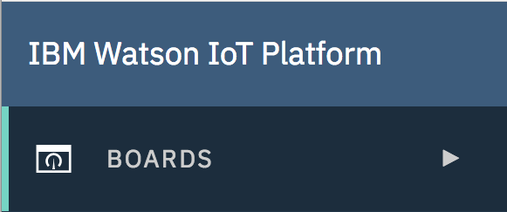
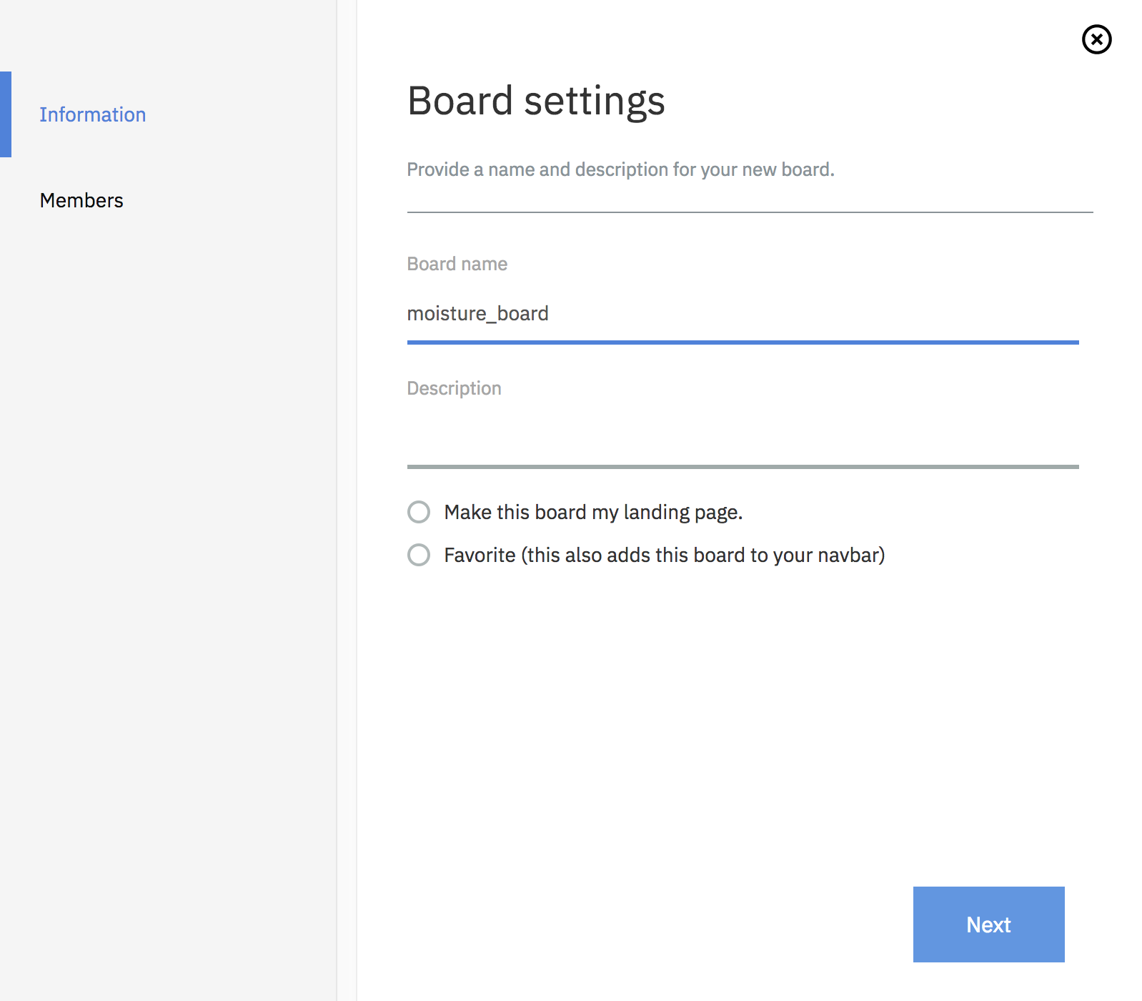
C. Visualize data on Watson IoT platform (moisture)
Visualizing moisture readings in Watson IoT.
The IoT device knows what it should do now: send all the moisture data to the IBM Cloud platform. But obviously, you want to do something with the data and visualize it. In this step, you will capture all the data within IBM Cloud and display it.
First go to Boards on the menu found in the top left of the IoT Platform website.
Create a new board.
Name your board ”air_quality_board", click on ”Next" and then "Submit". This board groups the IoT devices that you want to monitor together.

Slide 29
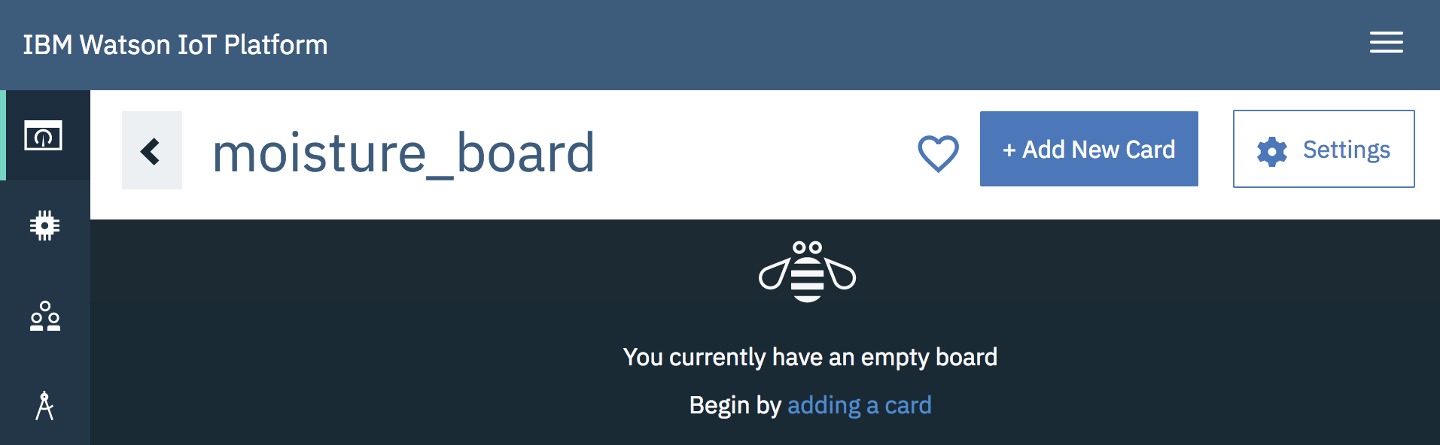
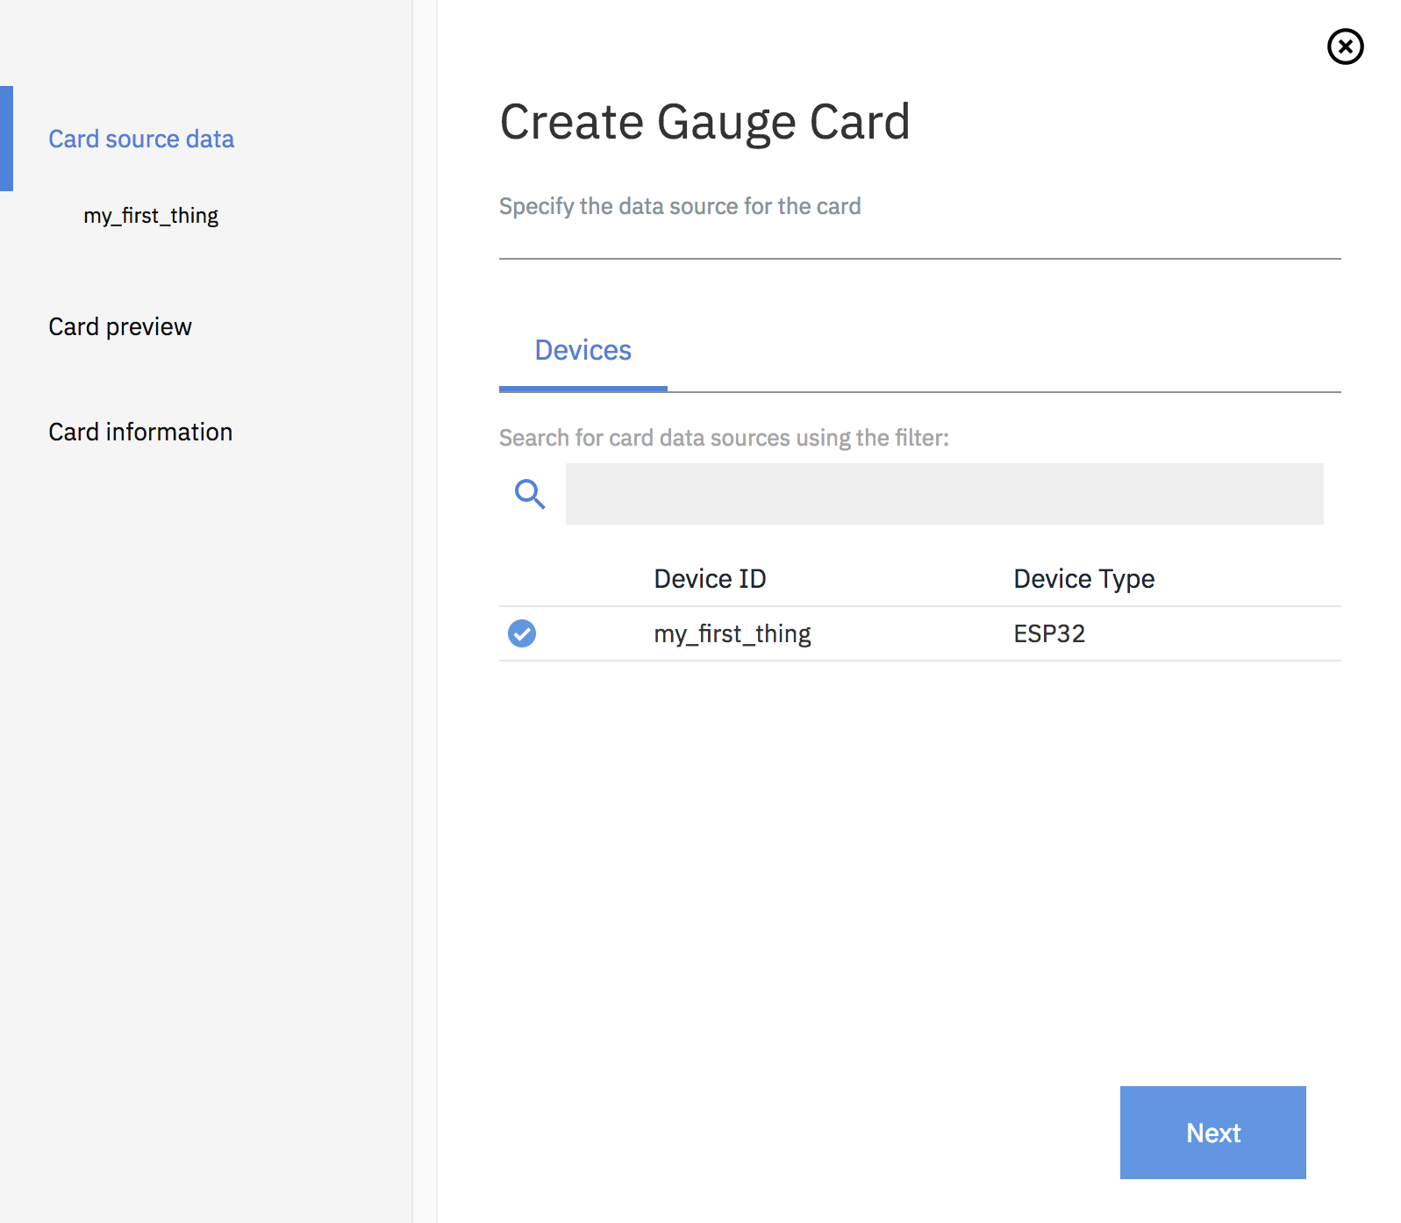
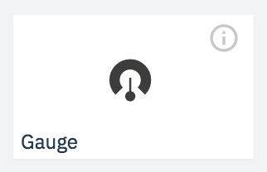
C. Visualize data on Watson IoT platform (moisture)
Click on your newly created board and add a new card.
Select "Gauge" from the list. This card will visualize our sensor readings.
Choose the IoT device to connect to this card and click “Next”.

Slide 30
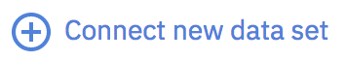
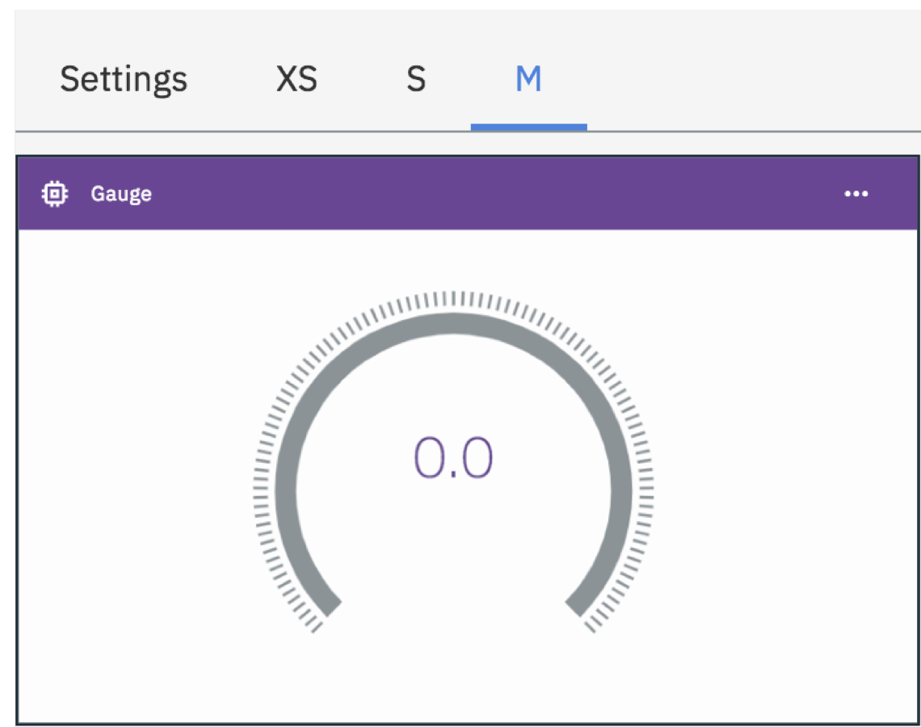



C. Visualize data on Watson IoT platform (moisture)
Connect a new data set.
And set it up according to the image below. The event name is status (case sensitive). In Property you choose the sensor reading you want to visualize. This is “moisture” in the example below, but you must select from the ones available in the dropdown menu.
In the case of humidity, the Type is Number, specified in percentage “%” and ranging from 0 to 100. Now, click “Next ”.
You can customize your card to your liking. For example, a large gauge meter can be chosen by choosing M in the Settings section. Click “Next”.
Here you can optionally name your card and change the color. Click ”Submit”.

Slide 31

C. Visualize data on Watson IoT platform (moisture)
Test your humidity sensor and watch the value being monitored in your card. Congratulations! You have successfully connected your IoT to IBM Cloud!

Slide 32
1n3cC_Vs1T@nTs.2019

Slide 33
IoT for environmental monitoring
Innovation Engine
Hand’s on workshop: further visualizing sensor readings
Notes:
Pieter Bruegel the Elder-
The Harvesters, 1565

Slide 34


Go to BlueMix.net and log in to your Cloud account
If not there yet, go to your Dashboard by clicking on the IBM Cloud logo
Under your Cloud Foundry Applications, open the one with the name you gave to the Internet of Things Platform Starter when you created it.
When it opens, click on Visit App URL

Slide 36


Click on Next
As this is a demo, you can avoid setting up access security. Click on Not recommended and tick the confirmation box

Slide 37


Click on Finish
Click on Got to your Node-RED flow editor

Slide 38



Click on the menu icon
Then on Manage palette
Click on the Install tab and type “node-red-dashboard” in the search bar
Then install node-red-dashboard

Slide 39




Click on Install
Once installation finishes, click on Close
Click on the dashboard logo on the upper left
Then click on Site and give it a title

Slide 40




Now go to the Layout and click on + tab
Mouse over Tab 1 and click on edit
Give it a name and click on Update
Mouse over your tab and click on + group

Slide 41


Mouse over Group 1, click on edit, and give it a name
Then click on Update
Repeat this process for the three remaining variables: Humidity, Dust, and Gas
Now click on the + icon below to create a new Flow tab

Slide 42



In your new Flow tab, filter available nodes by entering the word “IoT” in the search bar
Drag and drop to the right the input node called “ibmiot”
Do the same process for nodes “function” and “chart”

Slide 43


Now connect the nodes with each other. You can pull links from the gray circles
Double click on the IBM IoT node and enter an id for it. You can get that id from this website:
https://quickstart.internetofthings.ibmcloud.com/iotsensor/
Keep that tab of the virtual sensor open, we will need afterwards

Slide 44


Double click on the function node, configure it as follows, and click on Done
For convienience, here the code: return {payload:msg.payload.d.temp};
Double click on the chart node, and select Temperature [Sensor Readings] group

Slide 45


Now go to the bottom, and give this chart a name
Then click on Done
Deploy your application by clicking on the big red button to the upper right

Slide 46


Take your phone and navigate to:
<<your_app_name>>.mybluemix.net
Now, in your laptop, go to the tab of your browser were you left the virtual sensor (see note in slide 43)
Modify the temperature values, wait for some 10 seconds, and modify them a second time

Slide 47
Take a look at chart visualized in your phone. What happened?
Now repeat the process for the Humidity variable, redeploy, and visualize!
Afterward, try adding a gauge for both variables

